Slide 1


Slide 2

Virtual Reality — It’s Here
Head-mounted Display (HMD) sales forecasts call for 39M units annually by 2018, and a cumulative total of 83m HMD units in circulation over the five year period.*
* Sources: TechCrunch, KZERO Worldwide

Slide 3
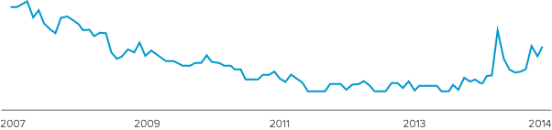
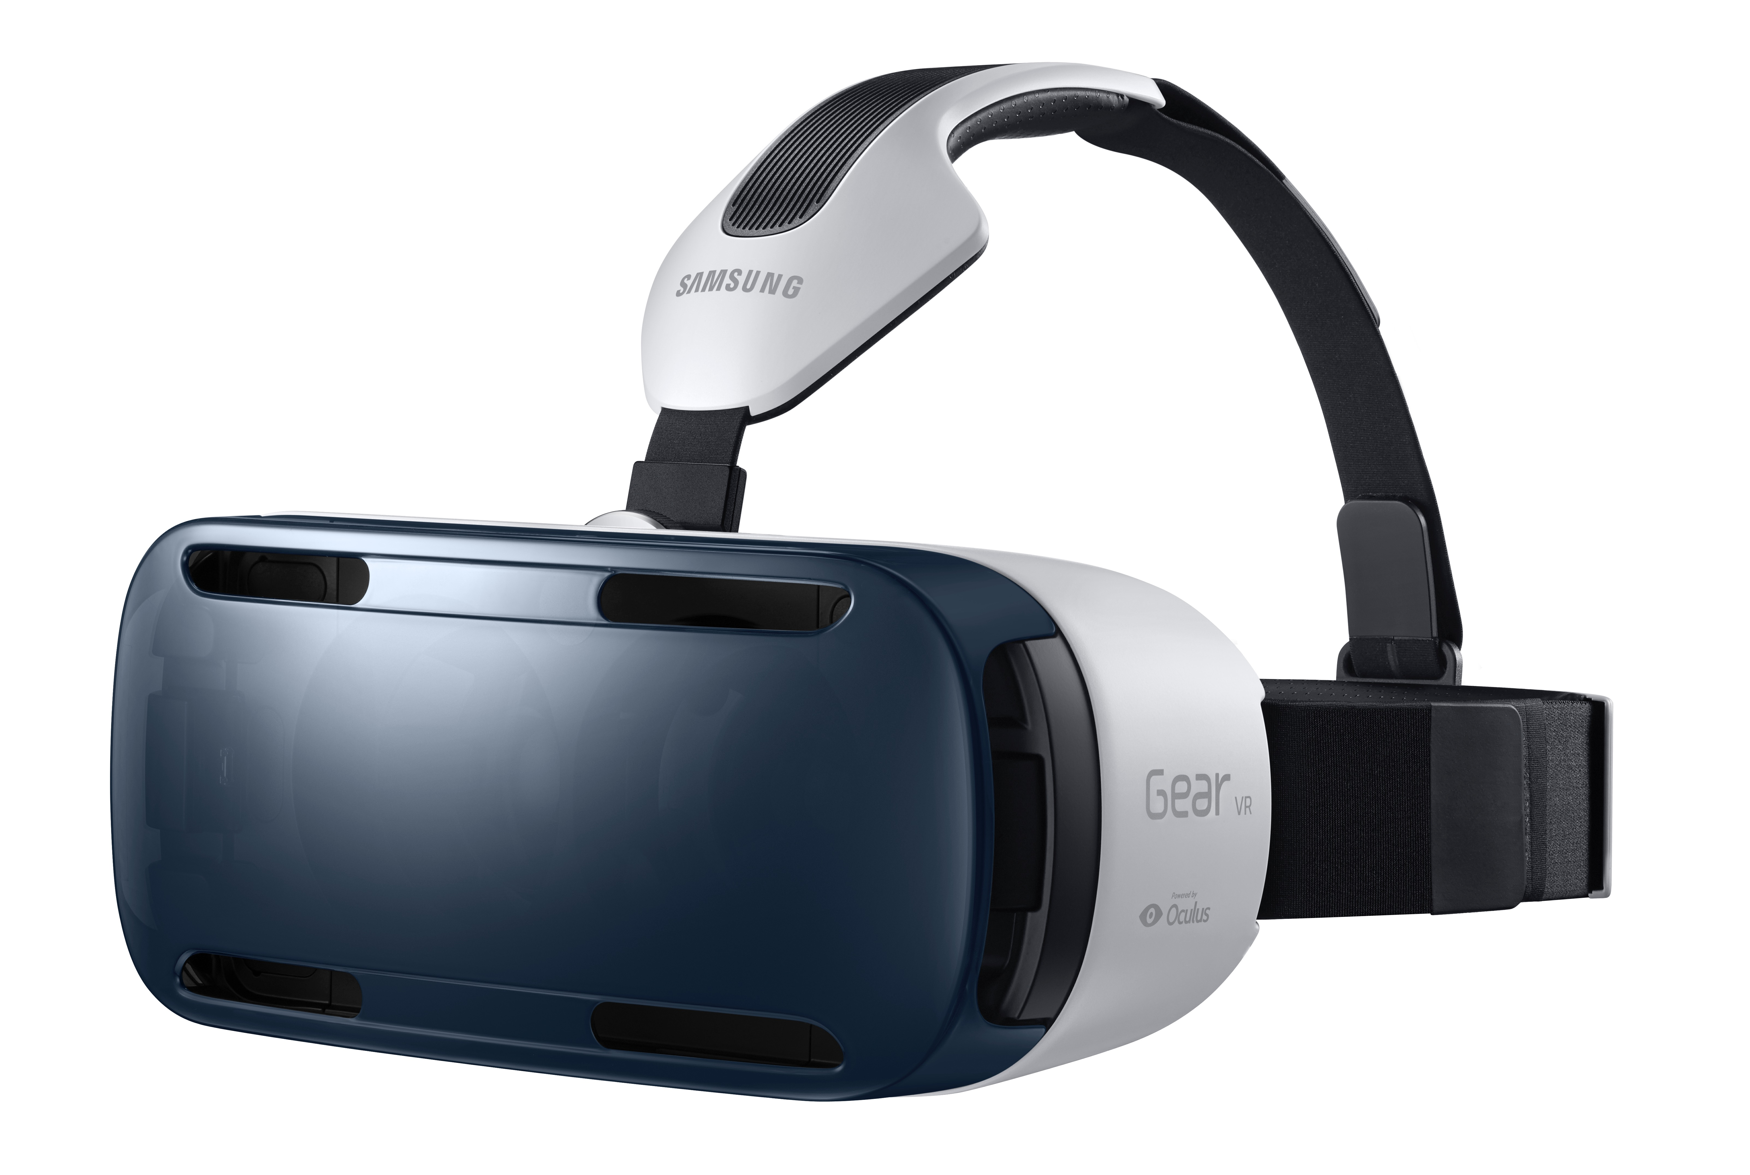
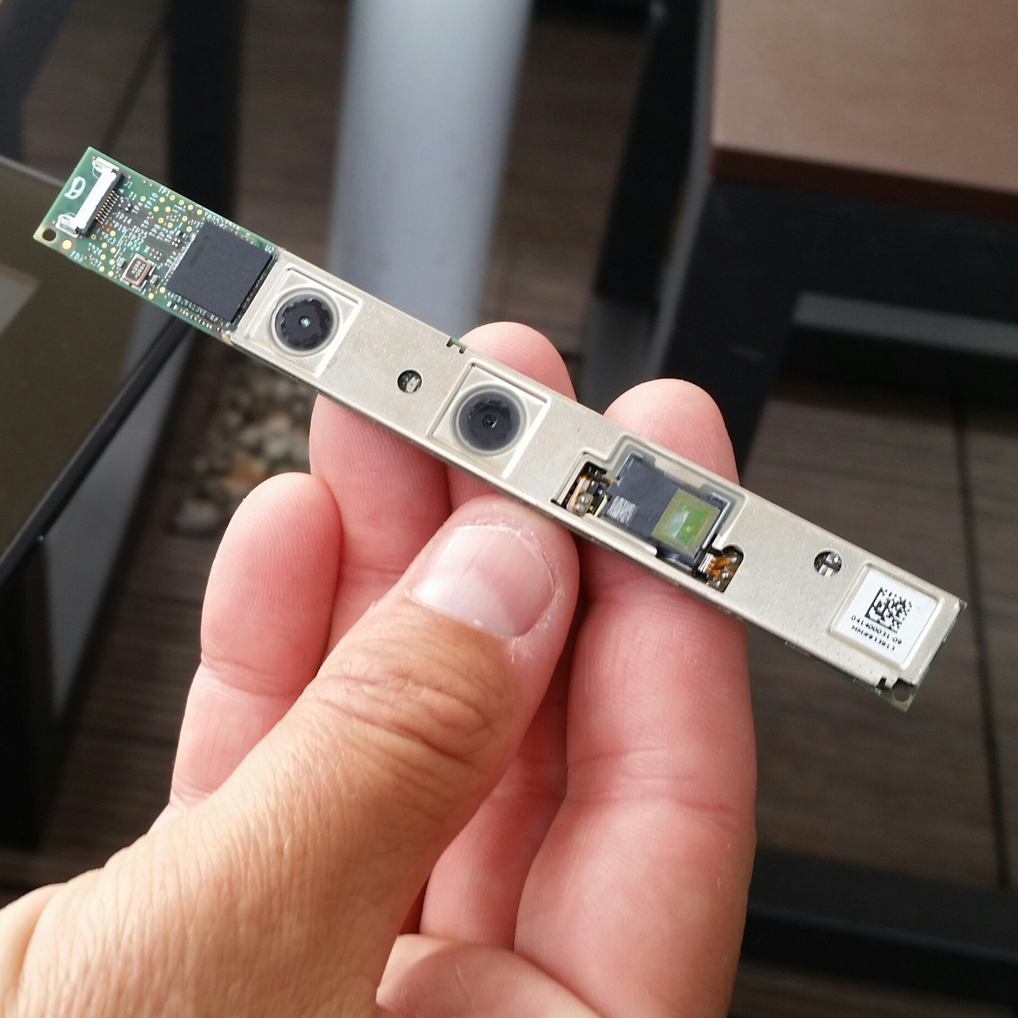

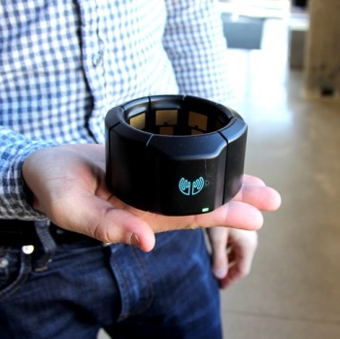
Why Now?
Renewed interest, marked by an explosion in interface devices
Google Search Activity Index for “Virtual Reality”
Samsung GearVR
Intel RealSense
3D depth camera
Leap Motion Controller
MYO Gesture Control

Slide 4


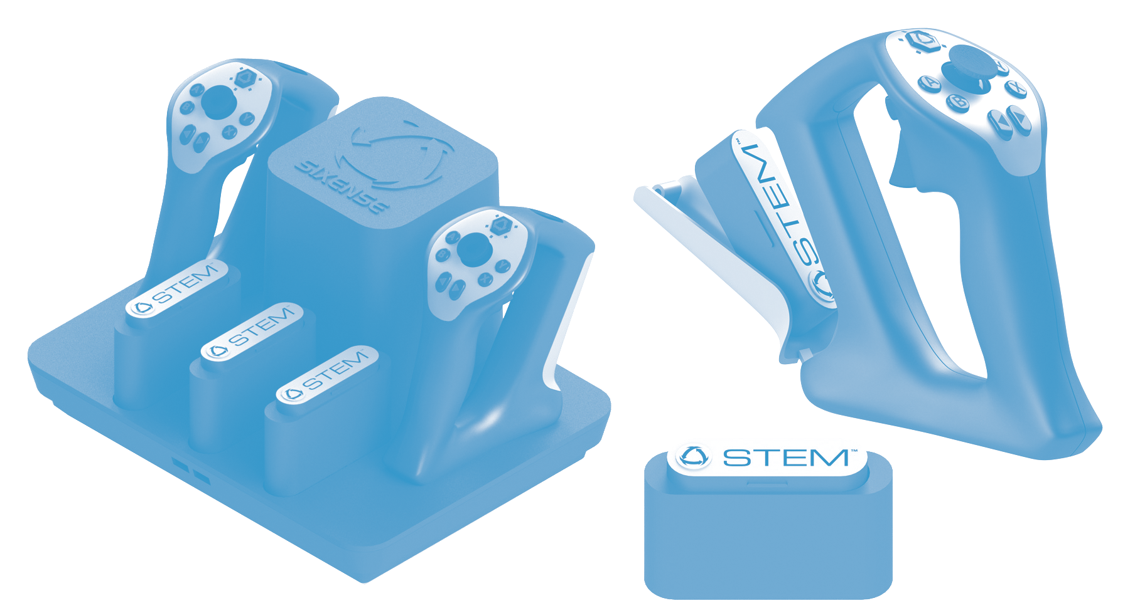

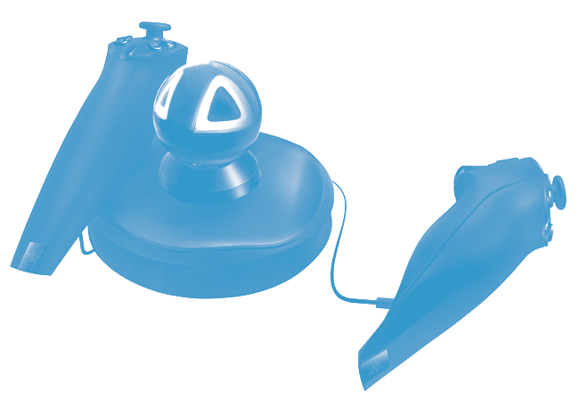
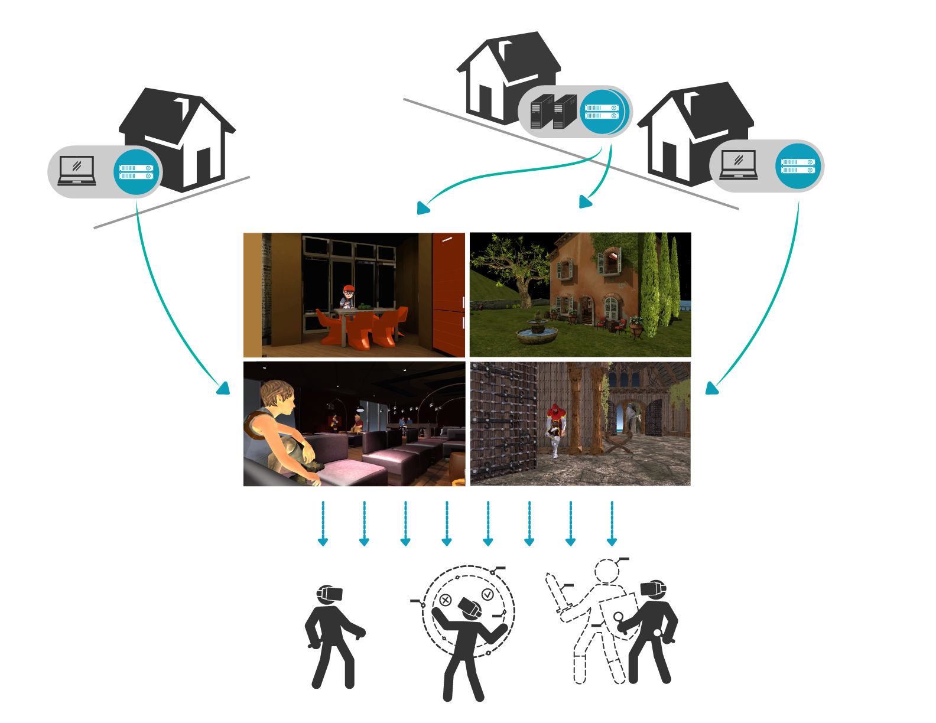
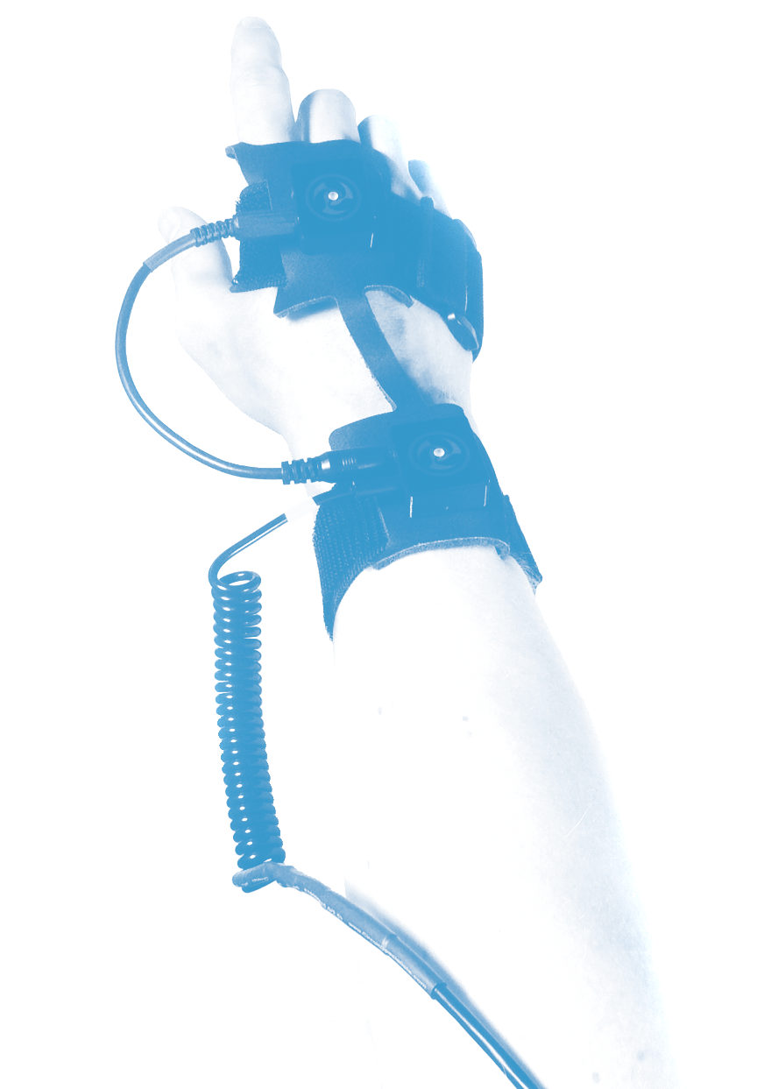

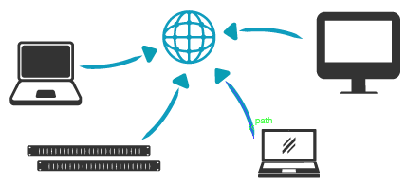
The Company
High Fidelity powers user-created virtual worlds, using these hardware devices to catalyze entirely new kinds of interactions.
1:1 Presence
Real-time low-latency face tracking support and 3-D spatialized audio
Collaborative Content Creation
Easily import objects from libraries in
standard formats
User Operated Domains
Download Hifi’s Stack Manager and run your own server
Shared Computing Power
Stream content to one another and share computing resources

Slide 5
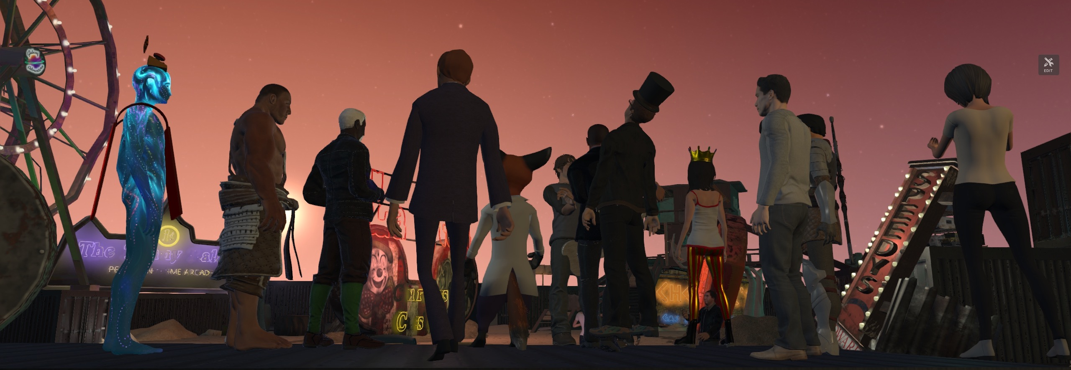





Thoys
Early Results
578 Alpha users enrolled representing 77 countries, with 4200 users on the waiting list. 9700 sessions logged over the last three months.
CtrlAltDavid
Judas
Netherlands
United States
United Kingdom
Time online to date:
Time online to date:
Time online to date:
97 hrs
177 hrs
421 hrs
Activities: Content creation, open source contributor, runs stack manager
Type: Integrator
Activities: Content creation (images, live music performances), runs Stack Manager

Slide 6
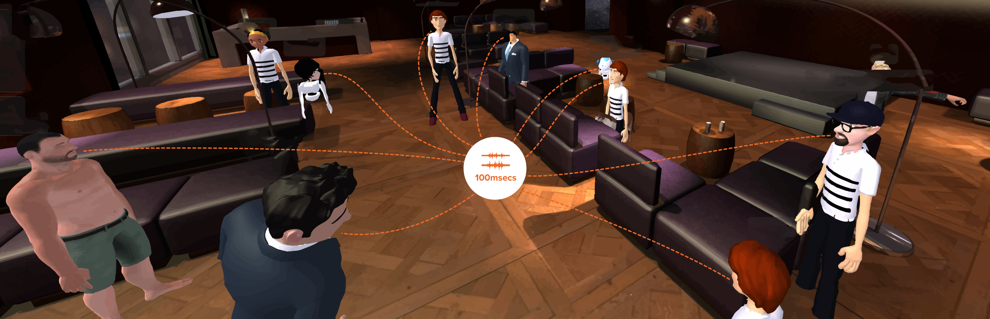
1:1 Presence
“The expressive faces looked incredibly human-like, which adds a whole other dimension to the interaction by invoking emotion.”
— quoVice News
Face tracking support
Joint motion capture support
3D spatialized audio

Slide 7
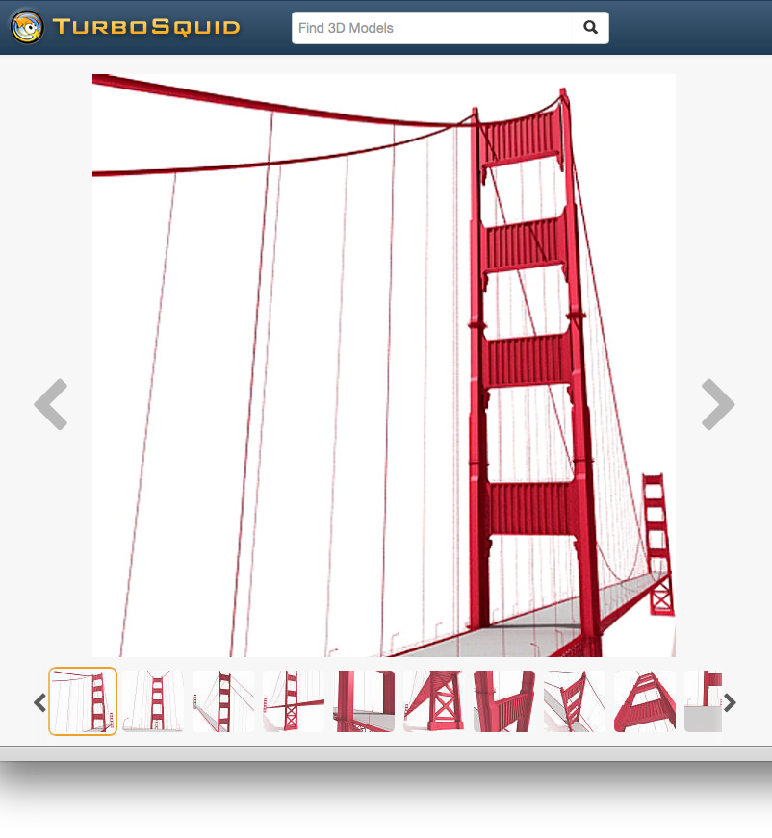
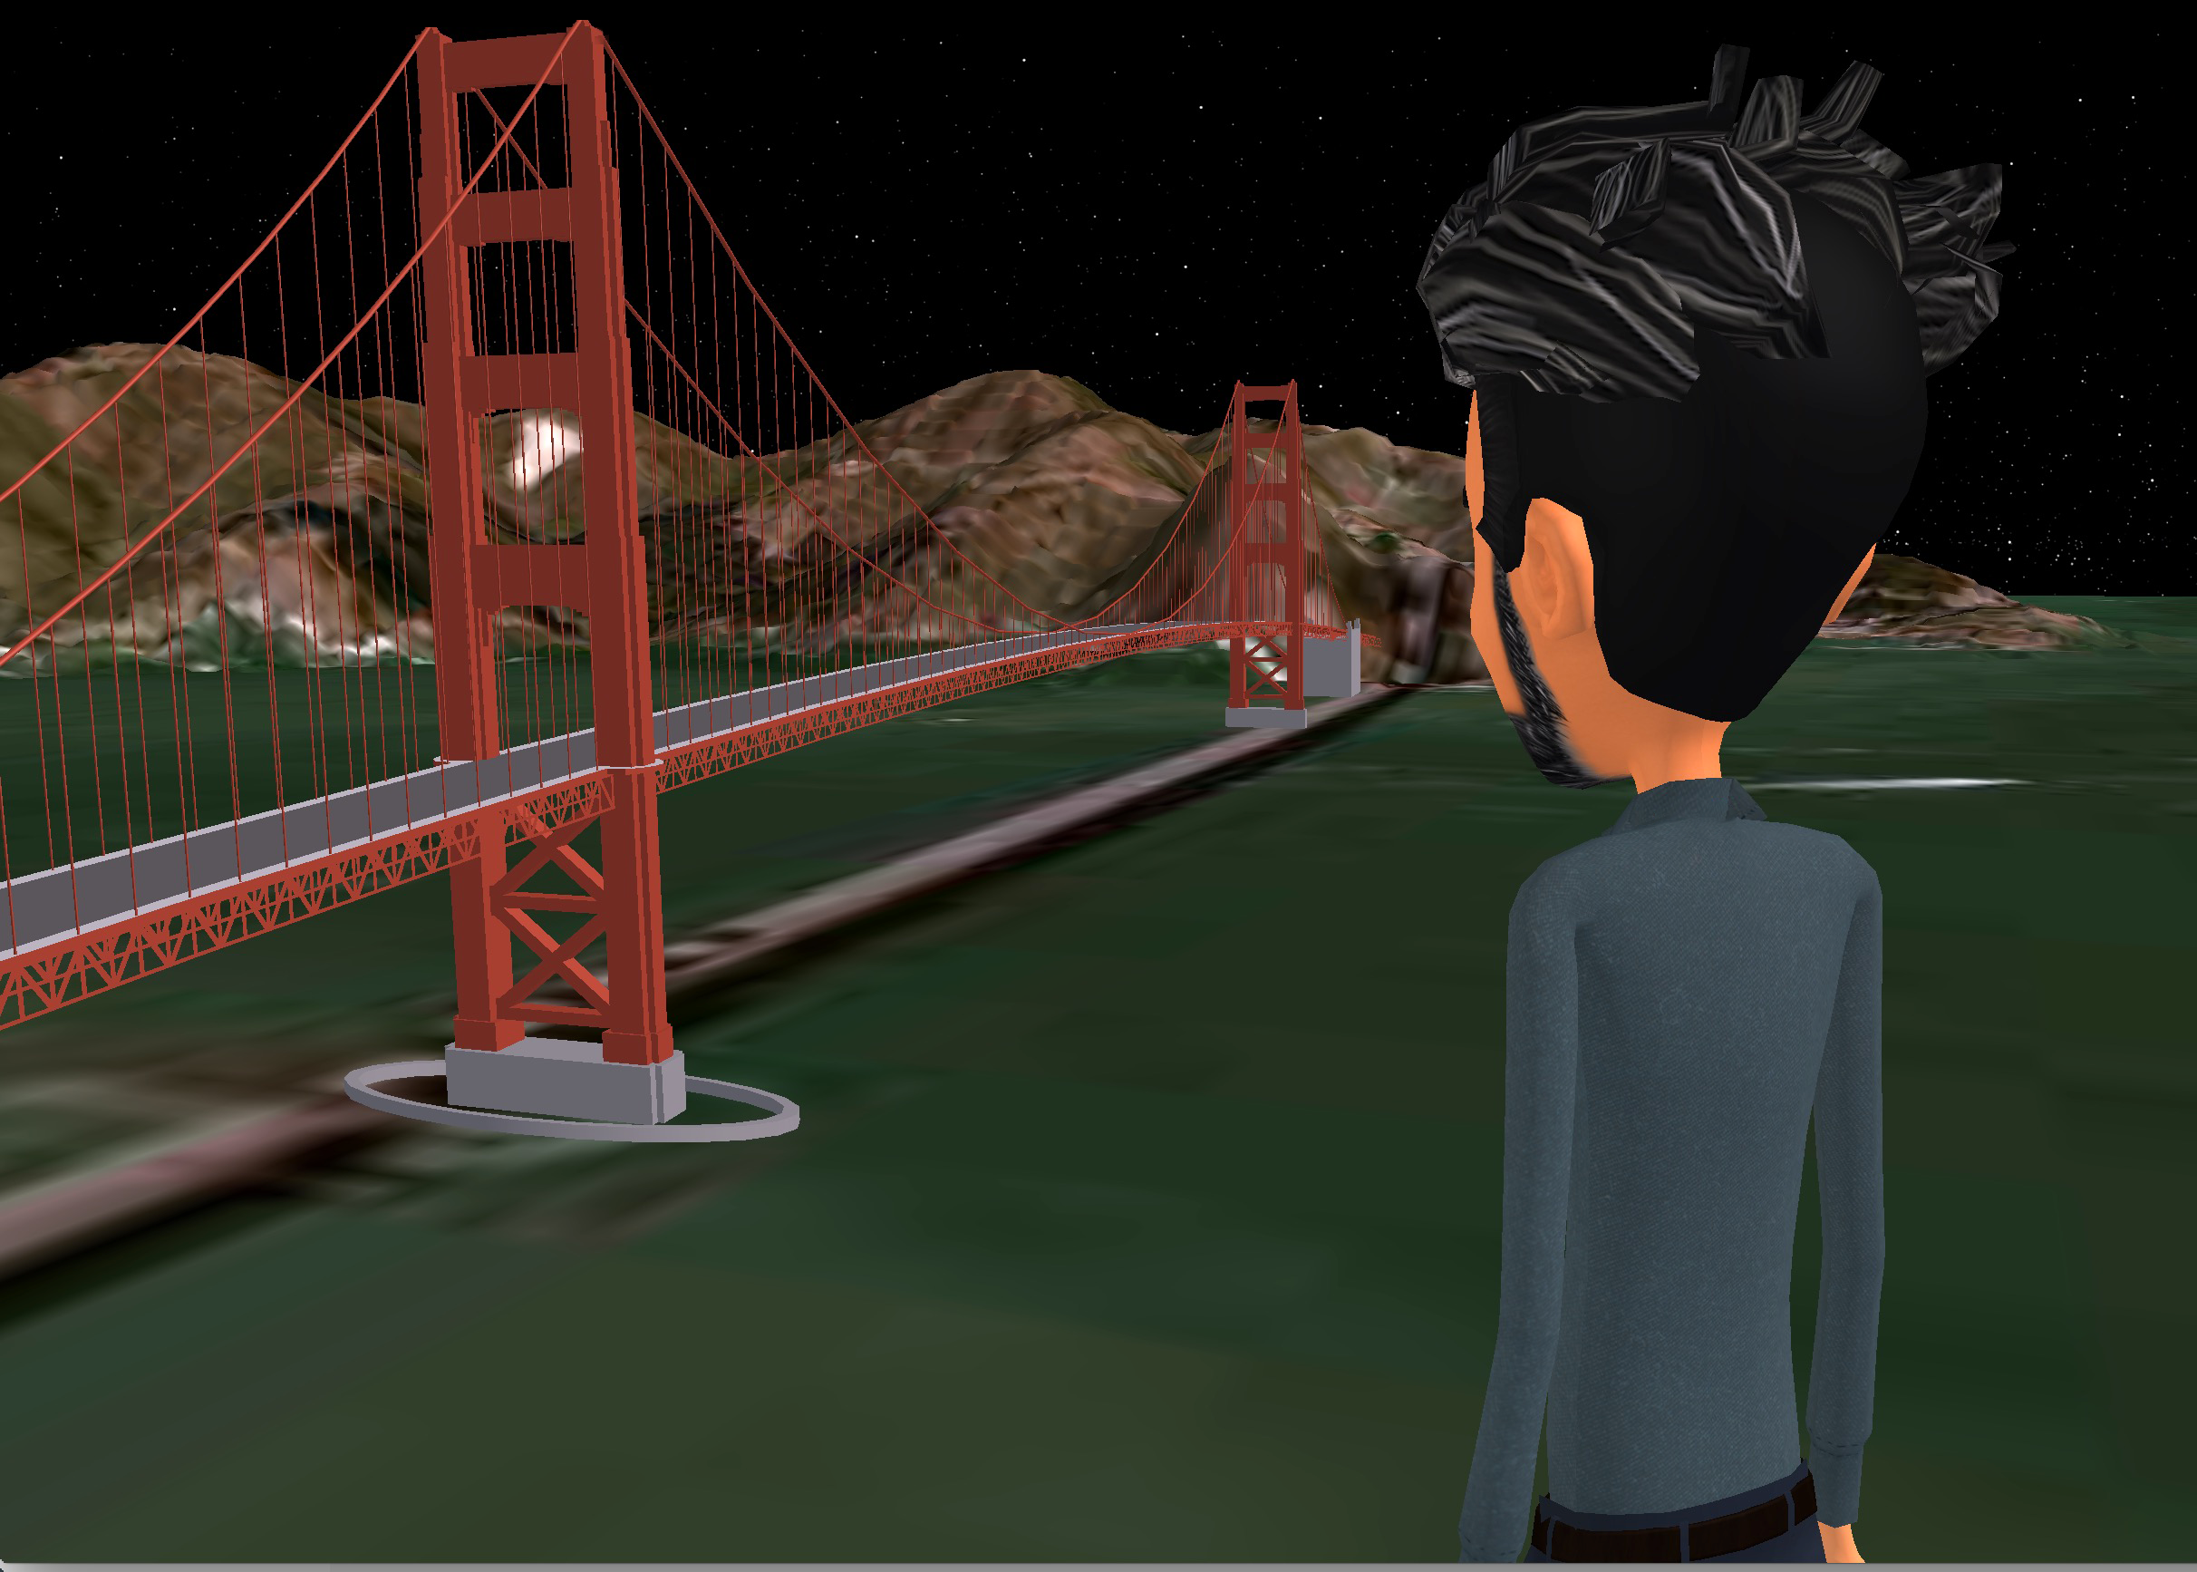
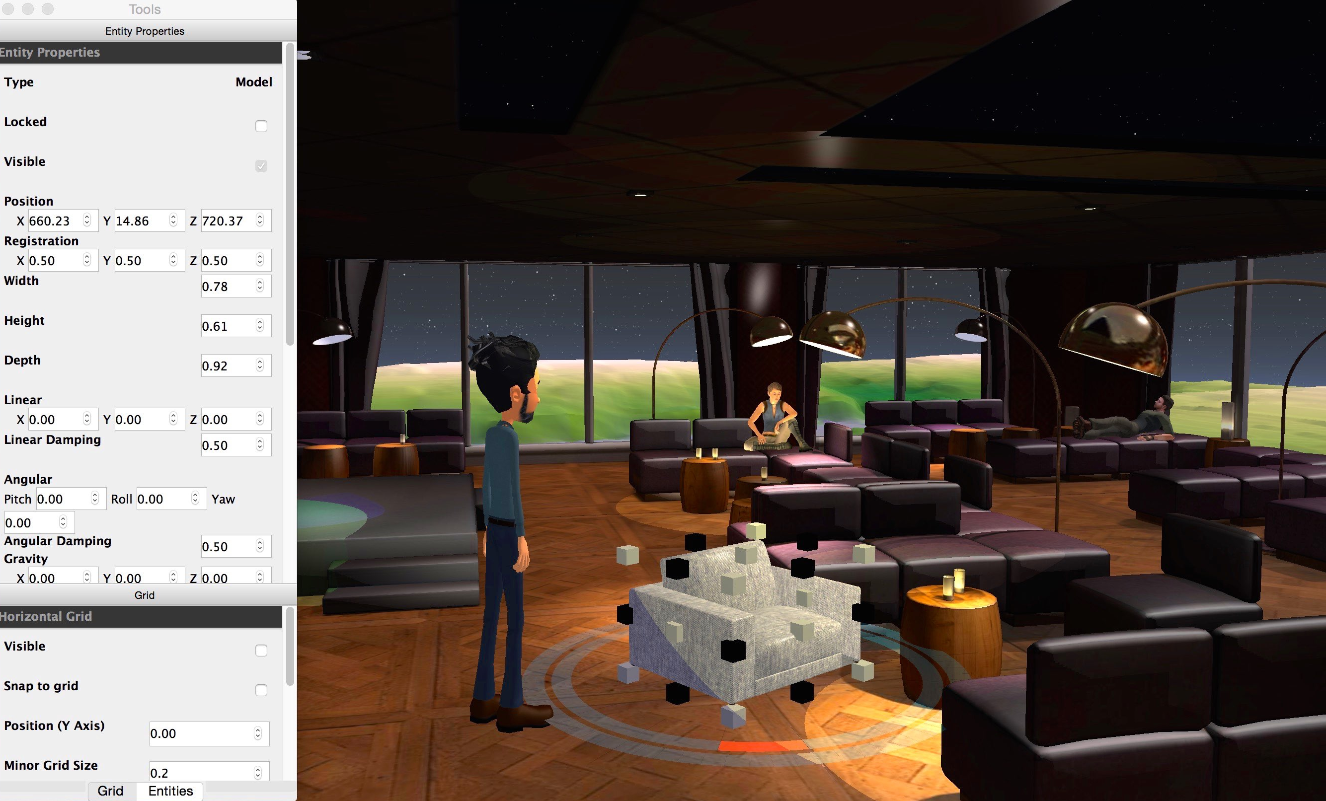
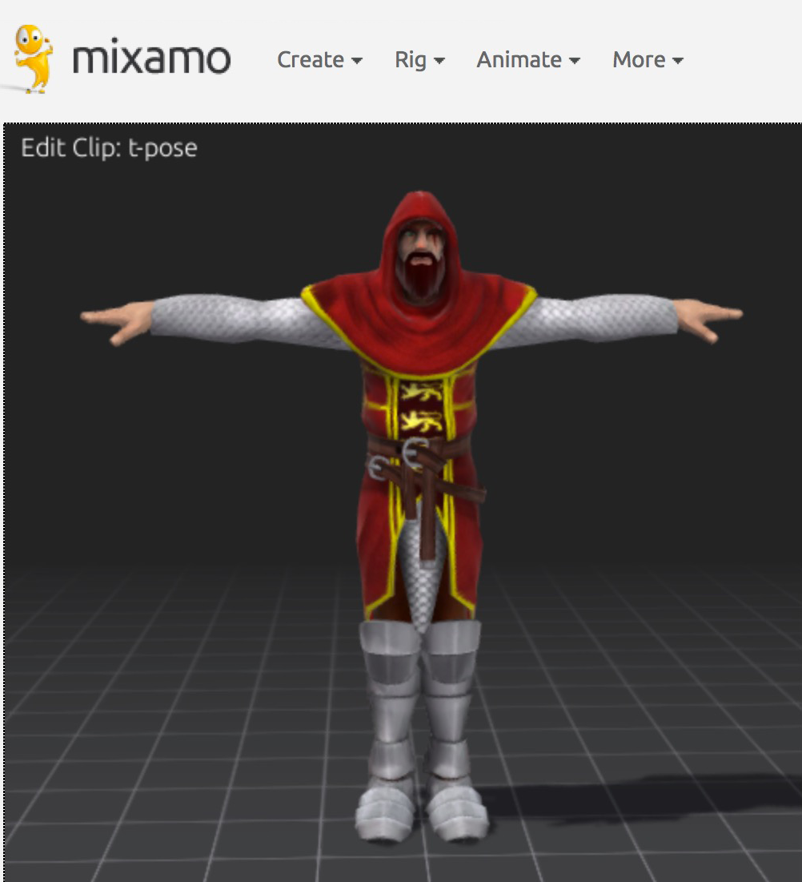
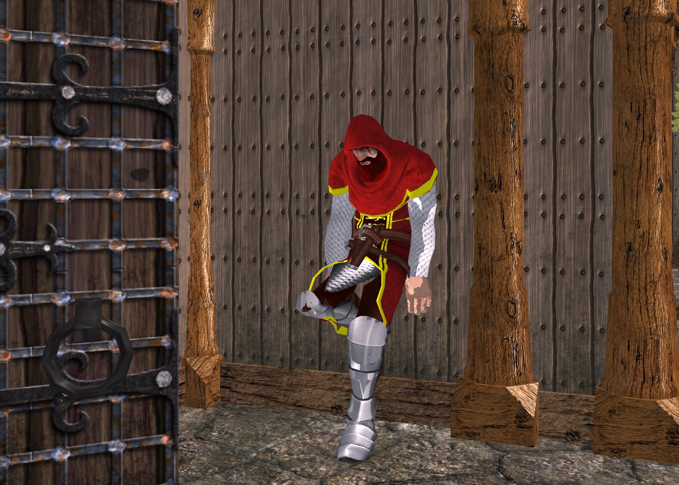
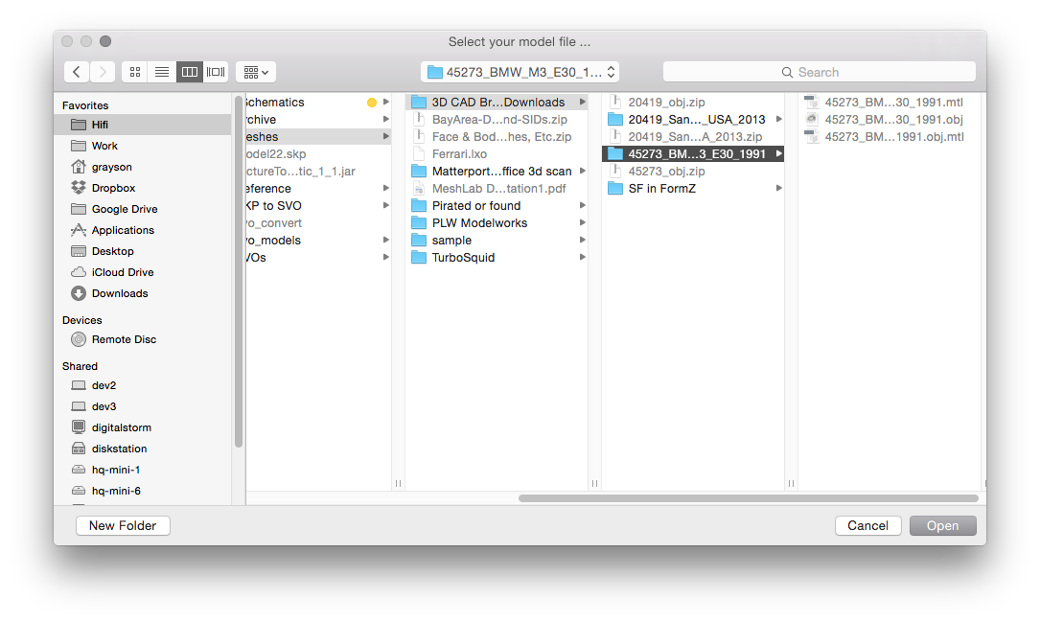
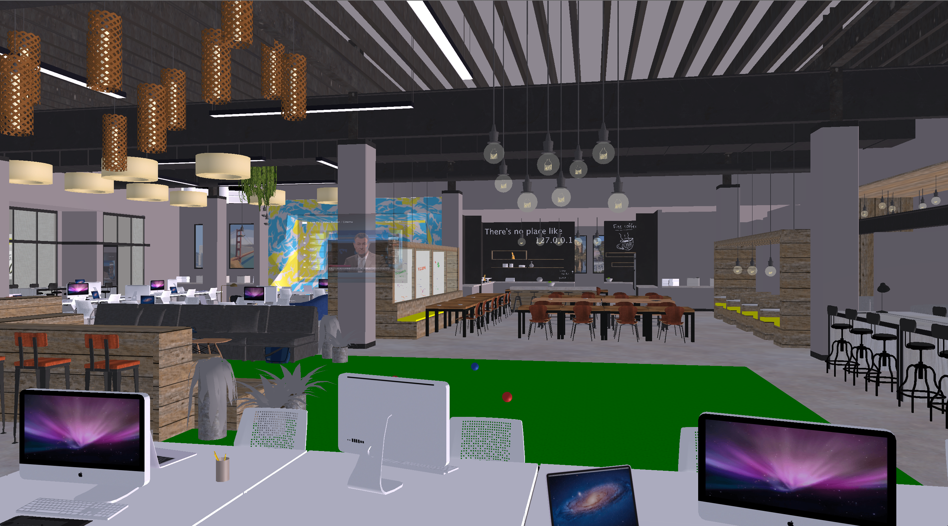
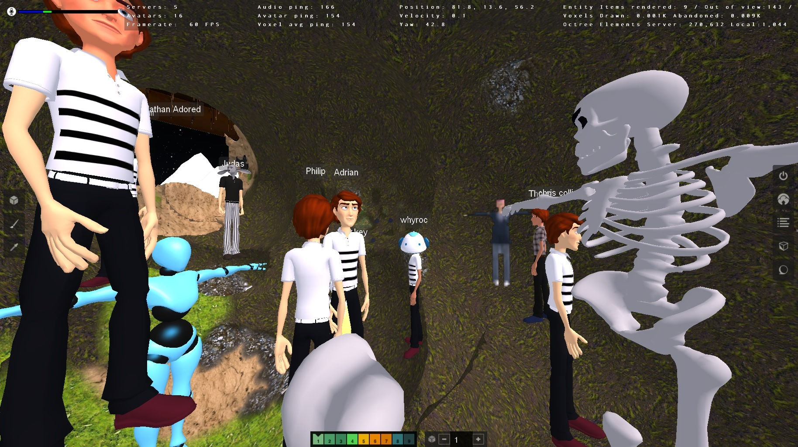
Collaborative Content Creation
Easily import objects from libraries in standard formats
Step 1: Import objects
Step 3: Place with precision & ease
Step 2: Import avatars
7￼
Import models
Edit terrain (screenshot of terrain editor being used)

Slide 8
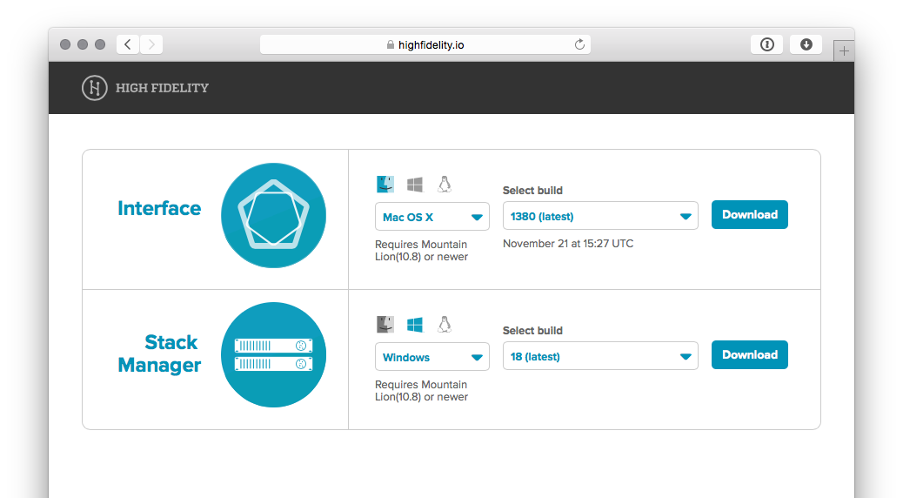
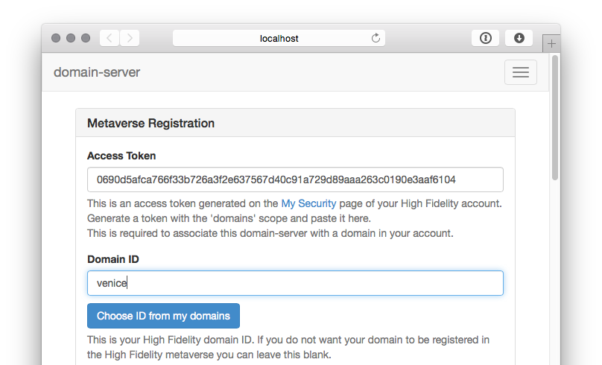
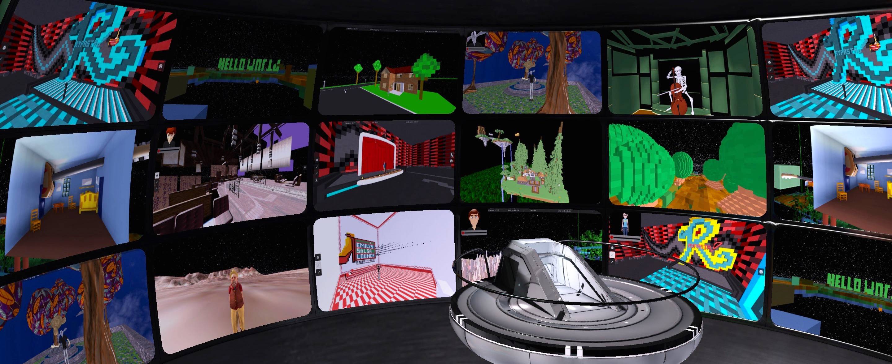
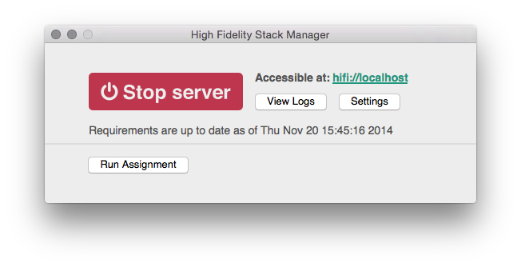
User Operated Domains
Hifi users can download Stack Manager and run their own server a la Minecraft
Self-installing Stack Manager
Domain control panels
Hifi’s lobby makes these domains discoverable
Time zone: PST
[DEBUG] [11/20 15:45:18] Could not find JSON config file at "/Users/grayson/Library/Preferences/High Fidelity/domain-server/config.json"
[DEBUG] [11/20 15:45:18] AccountManager URL for authenticated requests has been changed to https://data.highfidelity.io
[DEBUG] [11/20 15:45:18] Setting up LimitedNodeList and assignments.
[DEBUG] [11/20 15:45:18] Inserting assignment UUID: {10bd91c4-4cdc-4385-8f32-f3e9576889e4}, Type: 0 to static assignment hash.
[DEBUG] [11/20 15:45:18] Inserting assignment UUID: {d69e80c2-a6d8-4418-909a-e54cd70535a9}, Type: 1 to static assignment hash.
[DEBUG] [11/20 15:45:18] Inserting assignment UUID: {909636d2-77d3-424e-88ab-df8f7c401e06}, Type: 3 to static assignment hash.
[DEBUG] [11/20 15:45:18] Inserting assignment UUID: {c5b48082-76df-4928-8cb6-9f1d397783ad}, Type: 4 to static assignment hash.
[DEBUG] [11/20 15:45:18] Inserting assignment UUID: {726a7fc7-619d-4ffd-b25d-7b29d0d27d37}, Type: 5 to static assignment hash.
[DEBUG] [11/20 15:45:18] Inserting assignment UUID: {96d82d3f-850c-449e-9399-8b5fa97dc2b7}, Type: 6 to static assignment hash.
[DEBUG] [11/20 15:45:18] Asynchronously looking up IP address for hostname "stun.highfidelity.io" - lookup ID is 1
[DEBUG] [11/20 15:45:18] NodeList socket is listening on 40102
[DEBUG] [11/20 15:45:18] Changed socket "send" buffer size from 9216 to 1048576 bytes
[DEBUG] [11/20 15:45:18] Changed socket "receive" buffer size from 196724 to 1048576 bytes
[DEBUG] [11/20 15:45:18] Local socket is 10.0.0.154:40102
[DEBUG] [11/20 15:45:18] Reset UUID for assignment - UUID: {c67a659e-b2cd-4ee3-abb7-436640342a29}, Type: 4 - and added to queue. Old UUID was "c5b48082-76df-4928-8cb6-9f1d397783ad"
[DEBUG] [11/20 15:45:18] Reset UUID for assignment - UUID: {7e8c9551-0c77-41d3-a711-ea6e325a7a33}, Type: 3 - and added to queue. Old UUID was "909636d2-77d3-424e-88ab-df8f7c401e06"
[DEBUG] [11/20 15:45:18] Reset UUID for assignment - UUID: {61be1a4a-676a-4985-836a-76149bb5ce26}, Type: 1 - and added to queue. Old UUID was "d69e80c2-a6d8-4418-909a-e54cd70535a9"
[DEBUG] [11/20 15:45:18] Reset UUID for assignment - UUID: {1d9053ba-b418-4175-88e8-a4b1fbc30ff5}, Type: 6 - and added to queue. Old UUID was "96d82d3f-850c-449e-9399-8b5fa97dc2b7"
[DEBUG] [11/20 15:45:18] Reset UUID for assignment - UUID: {e5f78928-c753-4486-8ed5-14de06a3c96b}, Type: 0 - and added to queue. Old UUID was "10bd91c4-4cdc-4385-8f32-f3e9576889e4"
[DEBUG] [11/20 15:45:18] Reset UUID for assignment - UUID: {10d3d6f6-f531-4eb4-a528-51e9e27a38ae}, Type: 5 - and added to queue. Old UUID was "726a7fc7-619d-4ffd-b25d-7b29d0d27d37"
[DEBUG] [11/20 15:45:18] A domain-server feature that requires authentication is enabled but no access token is present. Set an access token via the web interface, in your user or master config at keypath metaverse.access_token or in your ENV at key DOMAIN_SERVER_ACCESS_TOKEN
[DEBUG] [11/20 15:45:18] Cannot setup domain-server automatic networking without an access token.
[DEBUG] [11/20 15:45:18] Please add an access token to your config file or via the web interface.
[DEBUG] [11/20 15:45:18] QHostInfo lookup result for "stun.highfidelity.io" with lookup ID 1 is "54.215.251.124"
[DEBUG] [11/20 15:45:19] Received a request for assignment type 7 from 127.0.0.1:49702
[DEBUG] [11/20 15:45:19] Deploying assignment - UUID: {c67a659e-b2cd-4ee3-abb7-436640342a29}, Type: 4 - to 127.0.0.1:49702
[DEBUG] [11/20 15:45:20] Received a request for assignment type 7 from 127.0.0.1:49702
[DEBUG] [11/20 15:45:20] Deploying assignment - UUID: {7e8c9551-0c77-41d3-a711-ea6e325a7a33}, Type: 3 - to 127.0.0.1:49702
[DEBUG] [11/20 15:45:22] Assignment deployed with "d4bd1a5a-a327-479a-833a-c31be2817e53" matches unfulfilled assignment "7e8c9551-0c77-41d3-a711-ea6e325a7a33"
[DEBUG] [11/20 15:45:22] Added "Voxel Server" (V) {23f717c4-d1de-46df-a461-63d10f6b3bad} 204.28.125.82:49702 / 10.0.0.154:49702

Slide 9
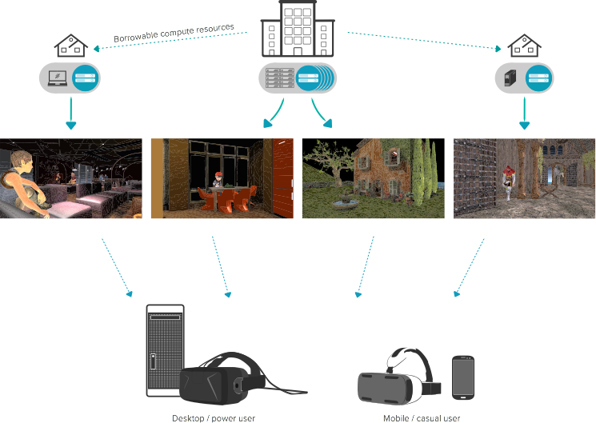
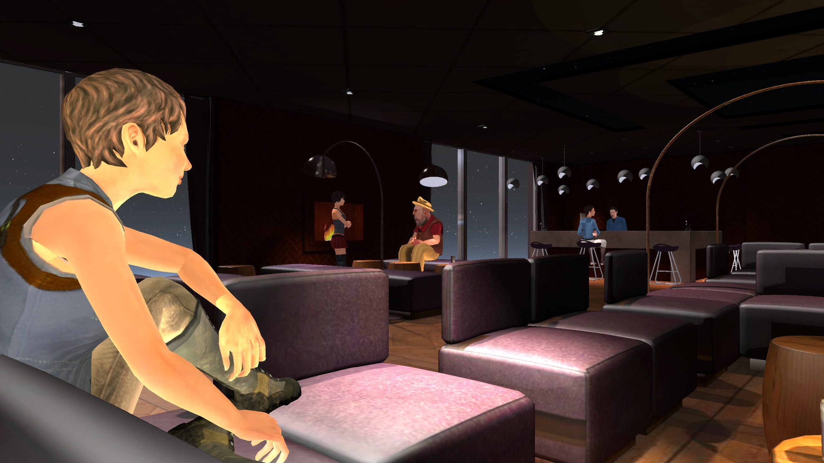


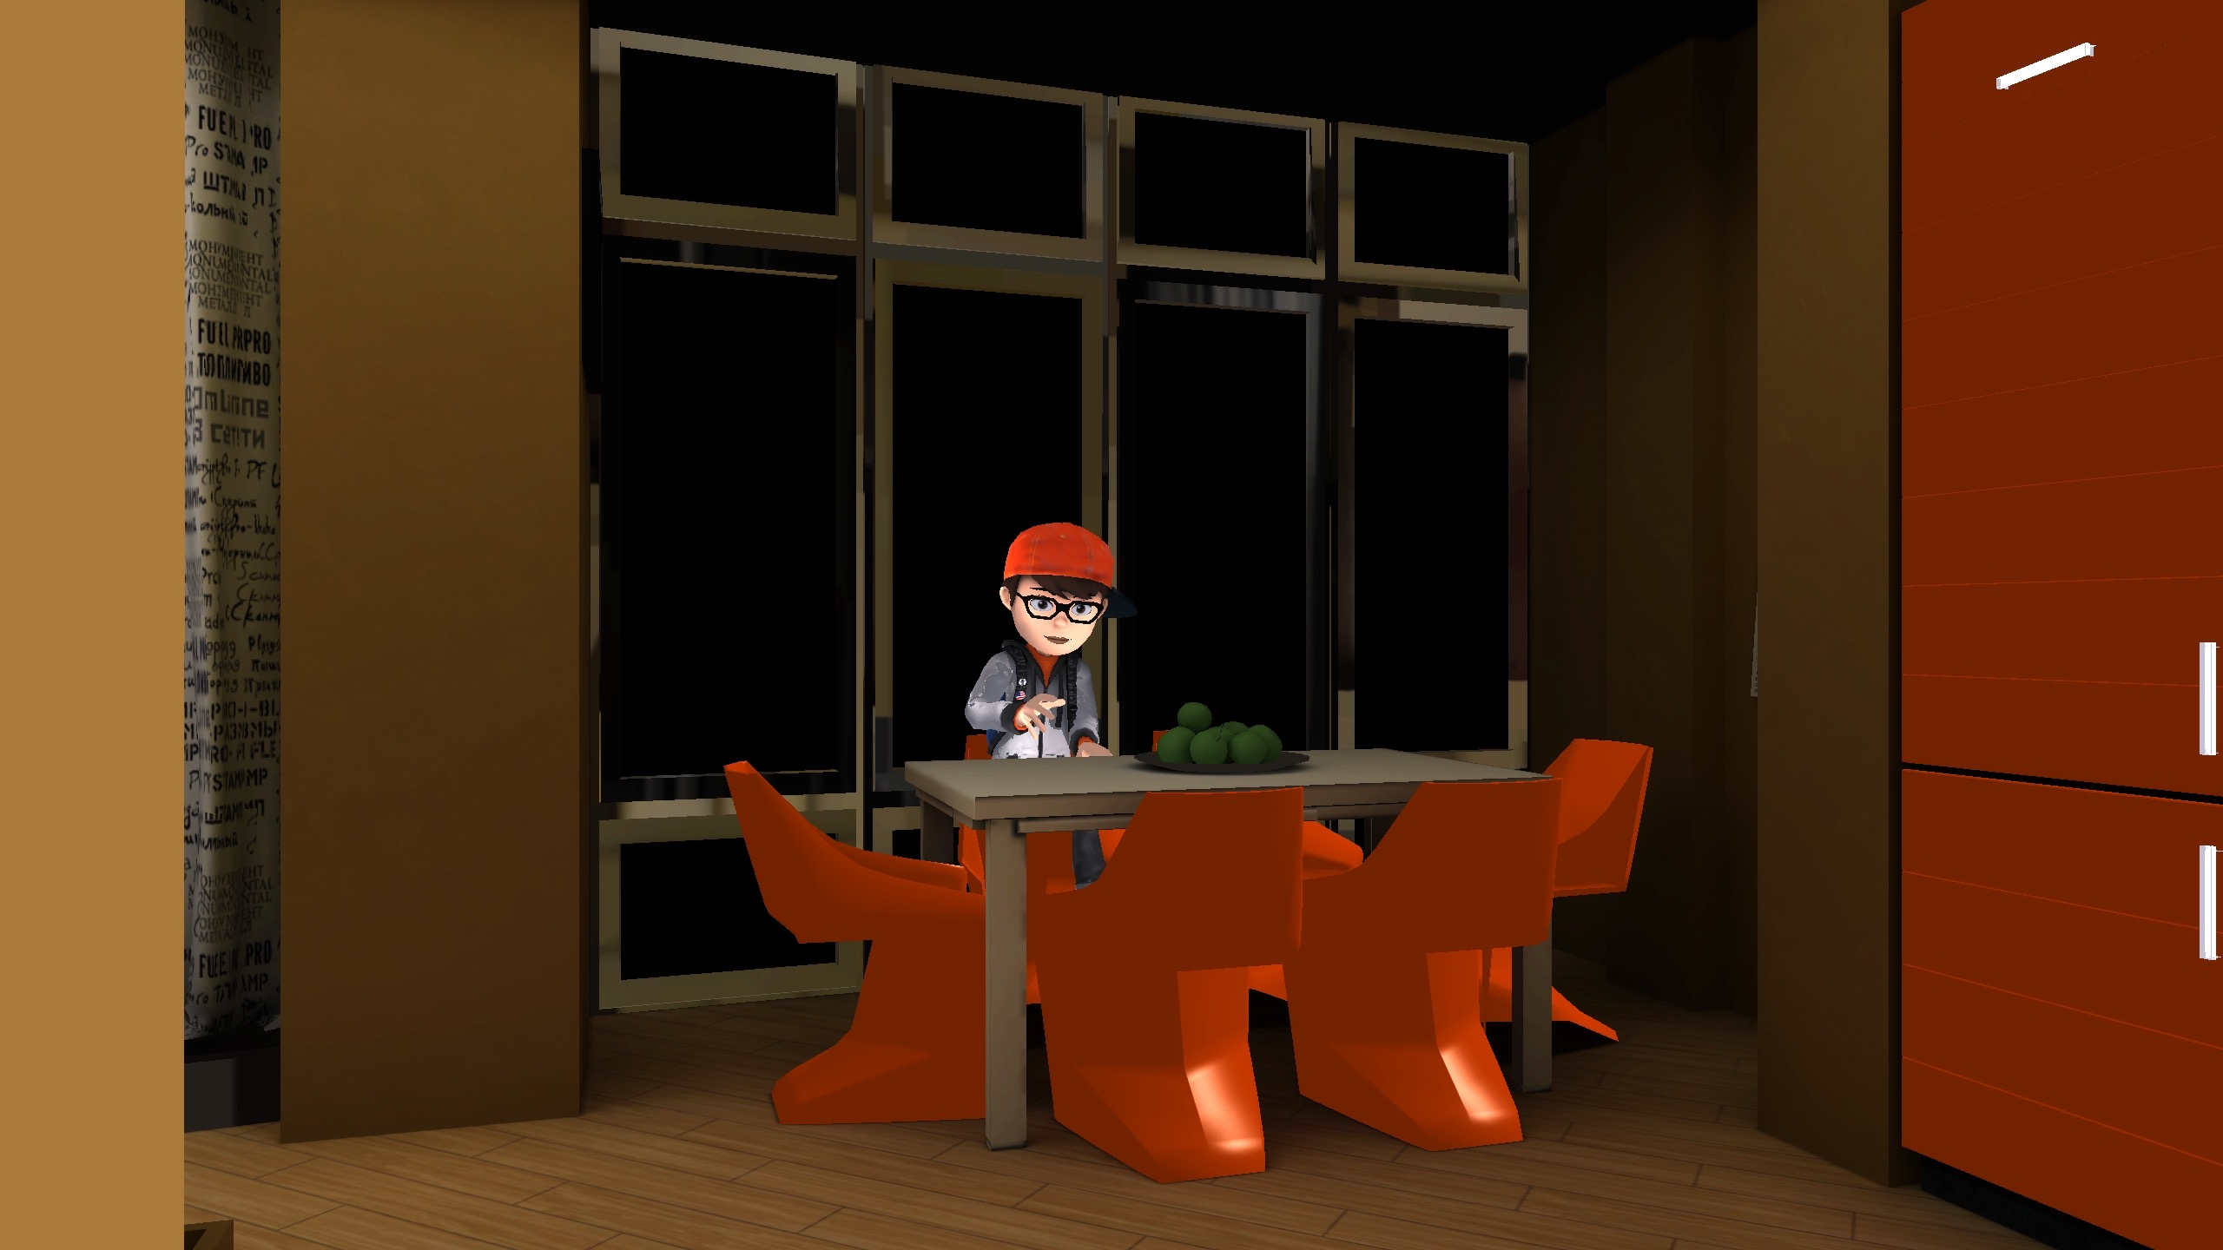



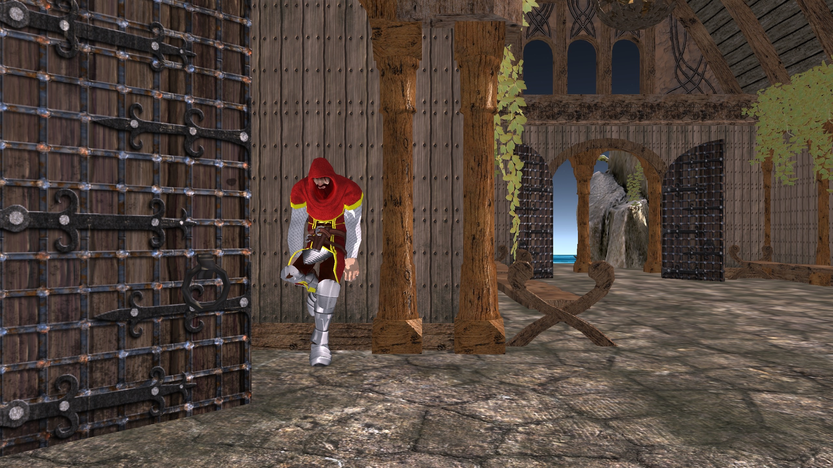
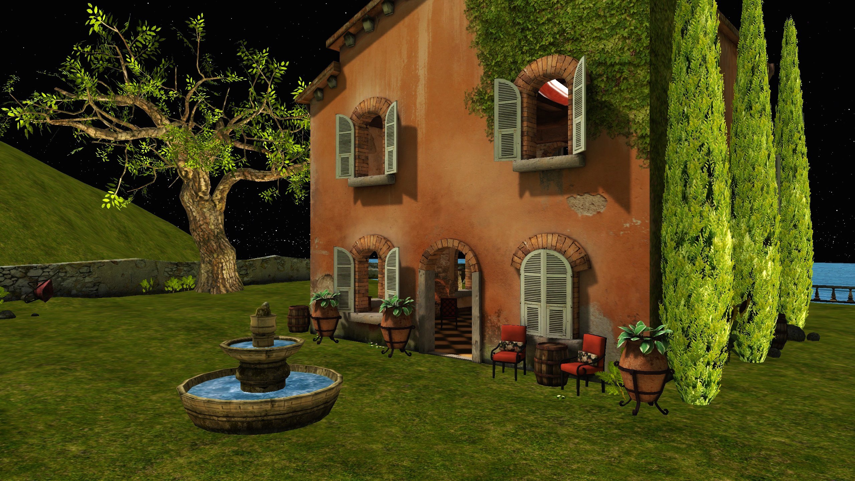

Shared Computing Power
With one click, users can stream content to one another and share computing resources, enabling infinite scalability.

Slide 10

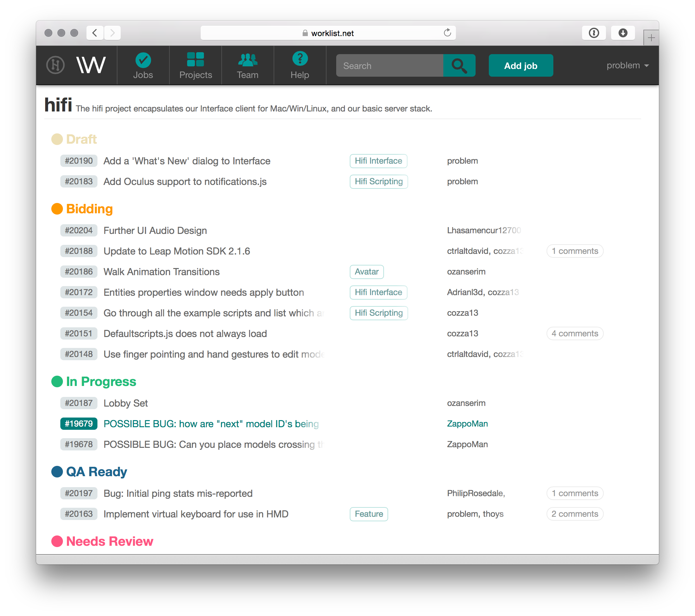
Scalable Engineering Talent
High Fidelity’s Worklist platform taps into a extended team of 30 software developers around the world.

Slide 11
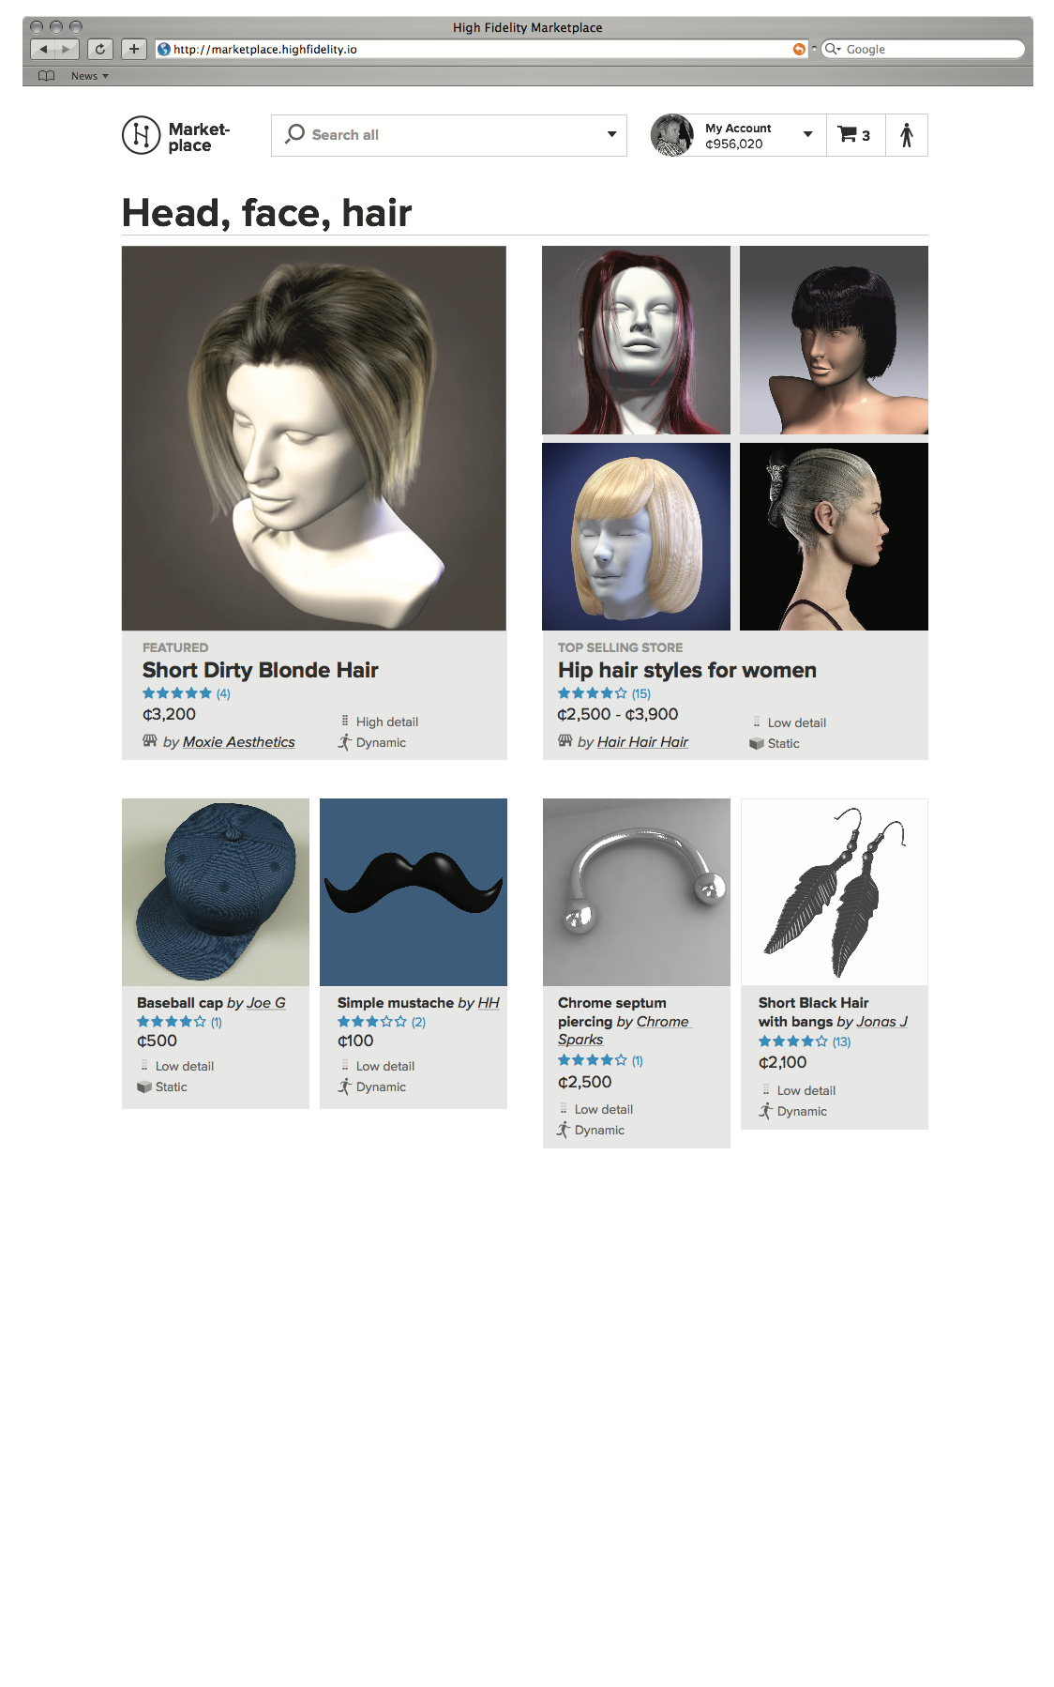


Revenue Streams
Naming Services
Registrants will pay for names that make themselves and their domains easily discoverable, and facilitate quickly jumping across servers.
Marketplace Fees
Users will pay listing and transaction fees for the sale and purchase of digital goods.
Computing Power Exchange
Users and operators will participate in the sale and purchase of the computing resources needed to power portions of the Metaverse.
Search & Advertising
Users will be aided by keywords and sponsored portals as they explore digital terrain.
#paris

Slide 12
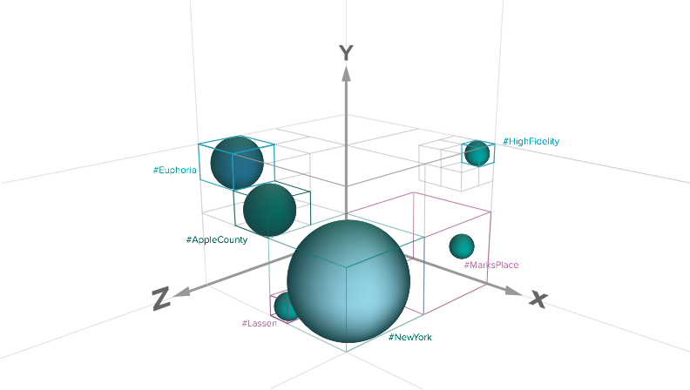
Unique Name Registration Fees
The existing DNS business generates 1.5B in annual revenue; we anticipate a similar market for unique names within virtual worlds.
The operator pays High Fidelity to register this unique name and associated server information.
A user can type “#NewYork” and be transported to a particular server operator’s virtual world.

Slide 13
Marketplace Transaction Fees
$6B in virtual goods are exchanged annually through Second Life and other virtual worlds. We expect to capture 5% of the incremental growth in that market through transaction fees.
A person buys virtual hair for their avatar, which then accompanies them as they
visit other virtual worlds.

Slide 14
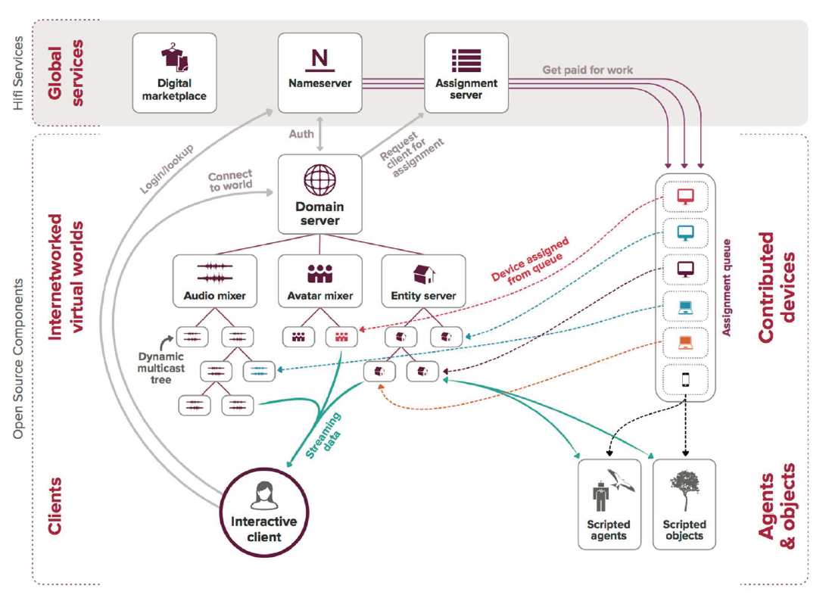
Computing Power Exchange
High Fidelity has been architected on the premise that user-contributed devices will power a good portion of the Metaverse.

Slide 15

Search & Advertising
Users will be aided by keywords and sponsored portals as they explore digital terrain.

Slide 16

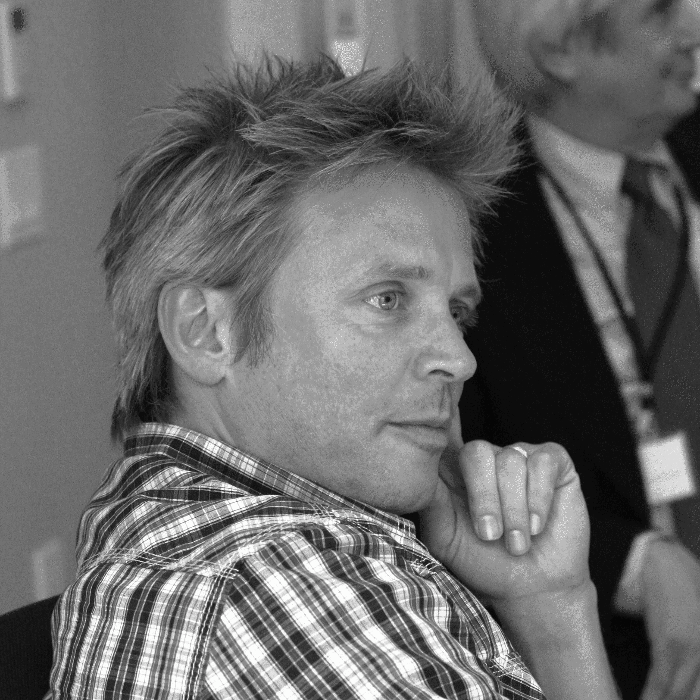
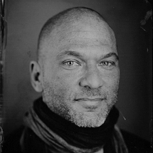




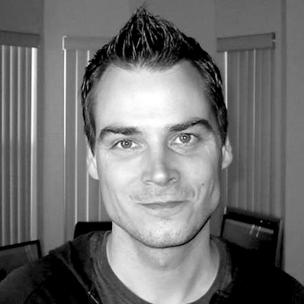





Core Team
14 full-time / 6 part-time engineers and designers with deep skills in high performance rendering systems, physics, simulations, networking, and audio processing.
Audio zealot, closet economist
VR/mobile game
veteran
Pixar feature film designer
Second Life
Don Corleone
Actual rocket scientist,
Second Life employee #1
Real Networks streaming media superstar
NVidia graphics
maestro
Touring rockstar / designer

Slide 17
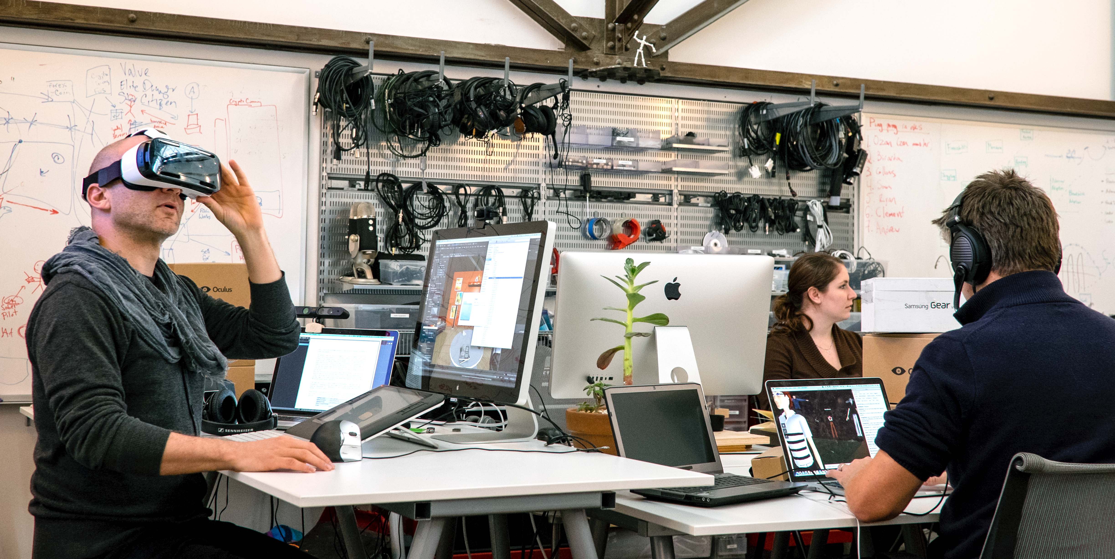
Next Steps & Use of Funds
Launch phase 1 product, Q1 2015
Start charging for Placenames, Q1 2015
Port to Samsung GearVR Headset, Q1 2015
Increase R&D headcount
Increase community management and support

