Slide 1
Building Virtual Worlds
in High Fidelity
Metaverse Bui1ding 101
Jazmin Cano
Marketing & Event Coordinator
HIGH FIDELITY

Slide 2
INTRO
What we’ll cover:
Download package
Sandbox
Interface
Building a space
Sharing it
Review
Demoing in VR

Slide 3
Open Source, Cross Platform
Plugin based hardware support
Input devices (Gamepads, Hydra, Vive, Touch, Spacemouse, Leap Motion)
Output devices (2D Displays, 3D displays,Vive & Oculus)
Physically based rendering (PBR)
FBX support
Scriptable avatars, entities & audio with Javascript
INTRO
Cool things about High Fidelity:

Slide 4


High Fidelity software has two parts:
Interface
Sandbox
For creating and exploring domains in High Fidelity.
aka: The Client
Hosts and manages your High Fidelity domain
aka: The Server

Slide 5
Sandbox

Slide 6
Server for your home domain
Configure your domain’s security settings
Share your domain address
hifi://Your-placename-1000
Purchase unique placenames for your domain hifi://playa
Assign Places/Paths
Set Pic & Description
Set Maturity/Rating
Choose Tags
Sandbox
Core Functions:
Your space in the metaverse!

Slide 7
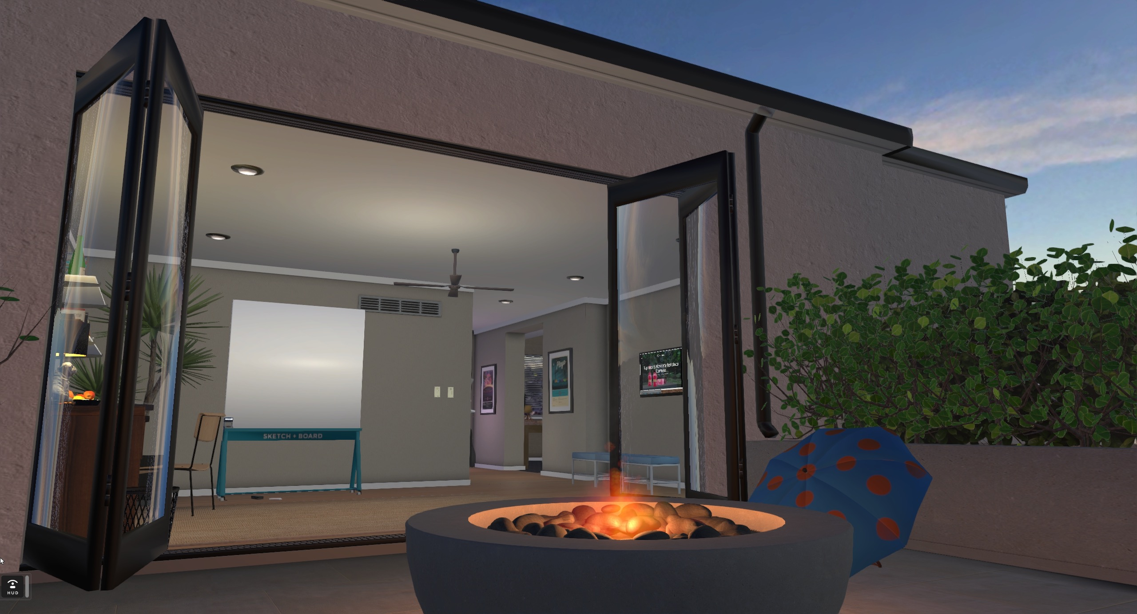
Sandbox
Default Home

Slide 8
Interface

Slide 9

Interface
The Metaverse Client
    Desktop mode
    + VR mode
    BUILD and modify things
    DISCOVER new
    Places
    Meet UP &
    Explore Together
    SHARE & FIND COOL STUFF

Slide 10
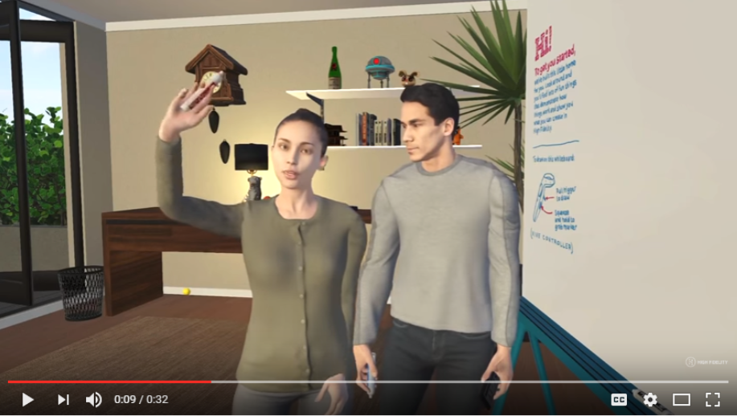

Slide 11
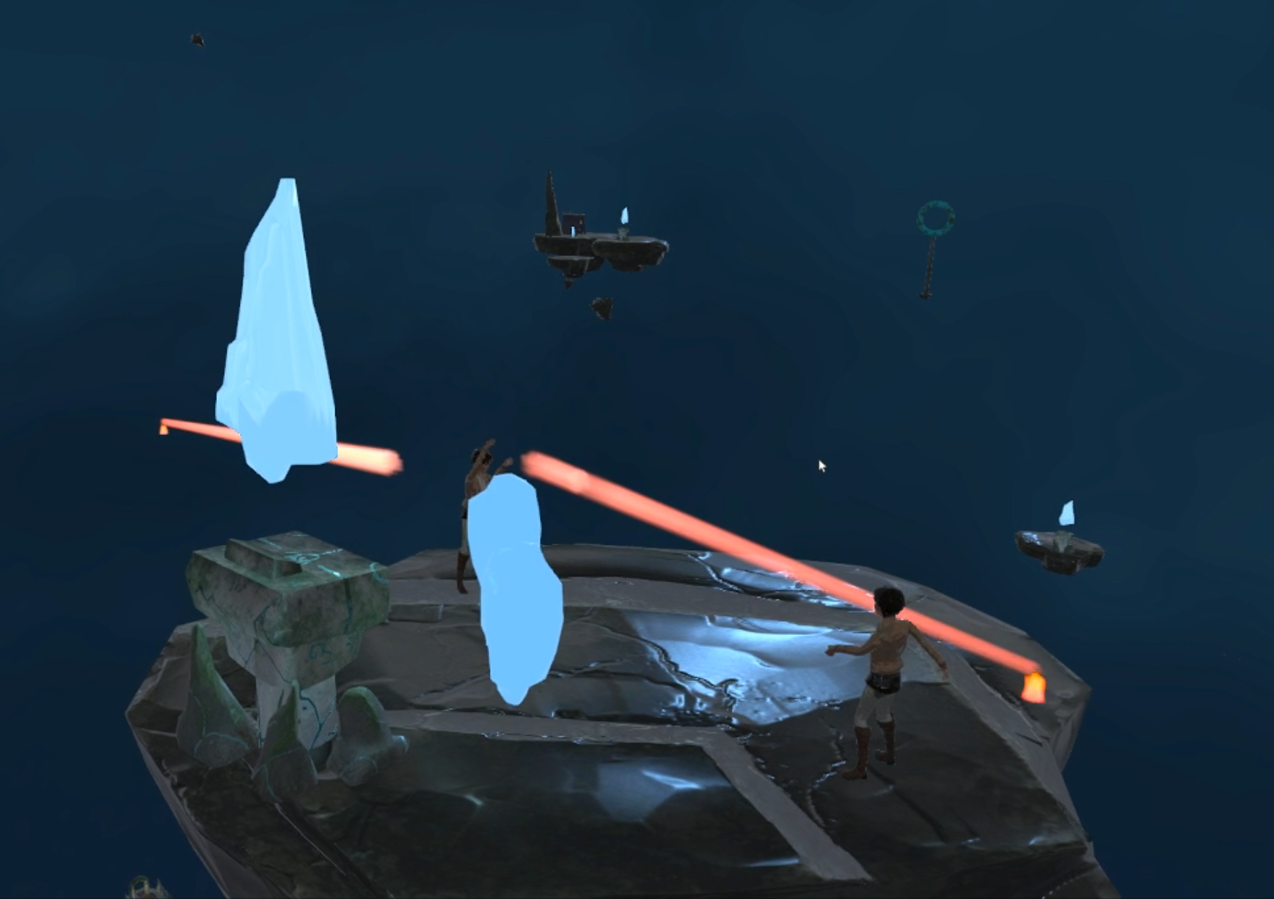

Start building your world

Slide 12
Creating Content
    UPLOAD MODEL TO a web Server
    EXPORT FBX MODELS from 3d AUTHORING software
    Import into HIGH FIDELITY
    or host it on your Sandbox Server

Slide 13
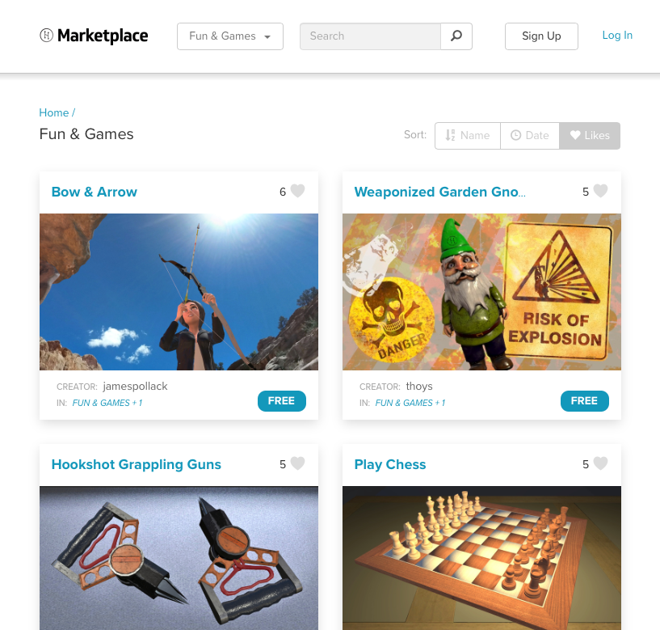
Adding Entities
    Tools to create New Entities
    Explore user-generated content in the Marketplace

Slide 14
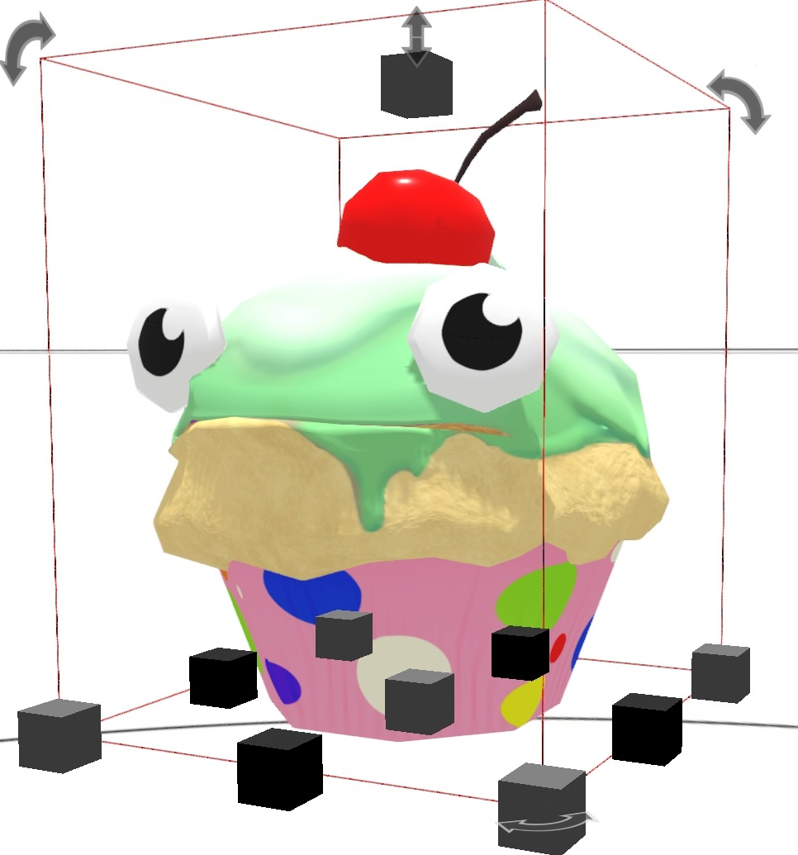
Editing Entities
    Name
    Parent
    Attach scripts
    Add audio
    Specify collision hulls
    Dynamic properties
    Add animation

Slide 15
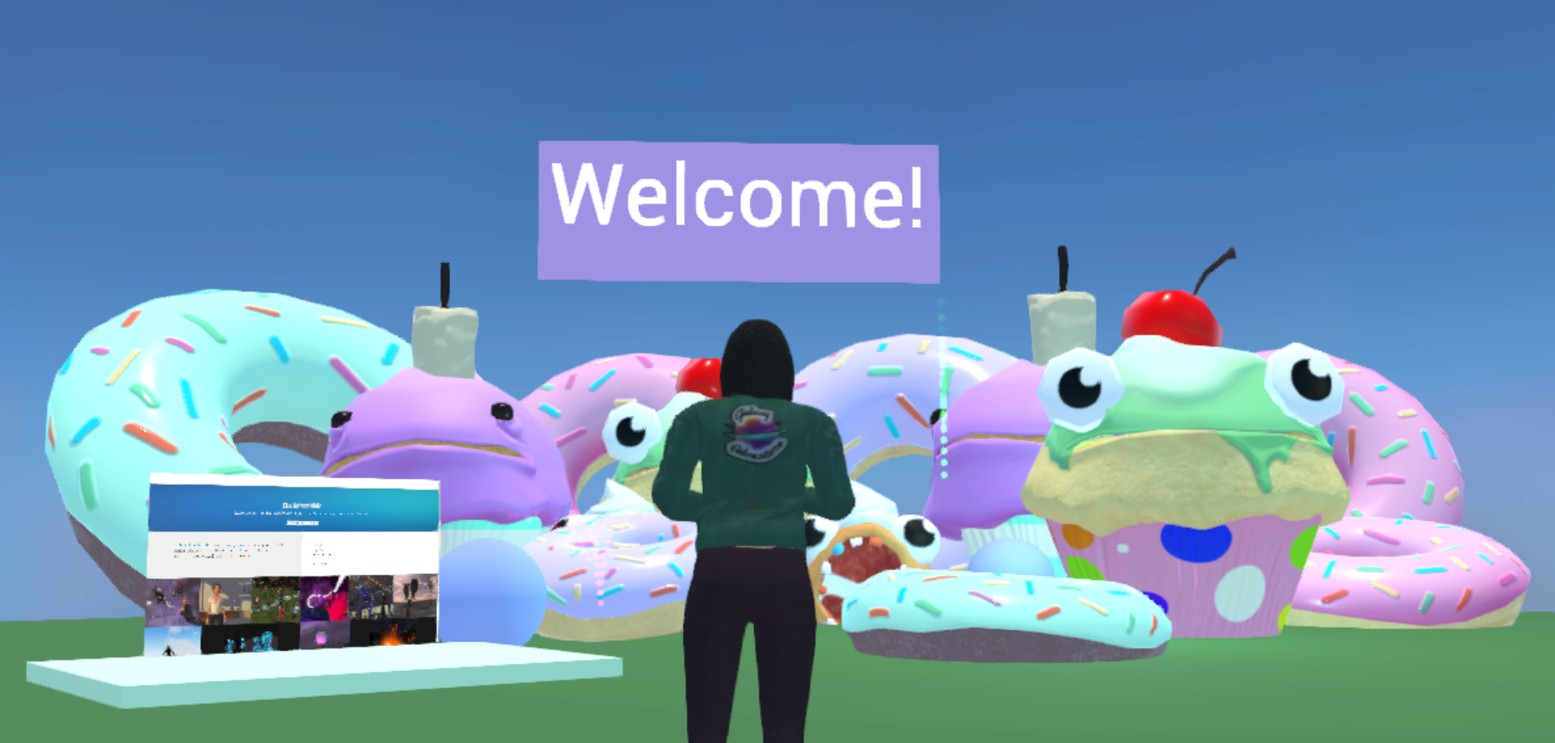
ta-DAAA!!

Slide 16
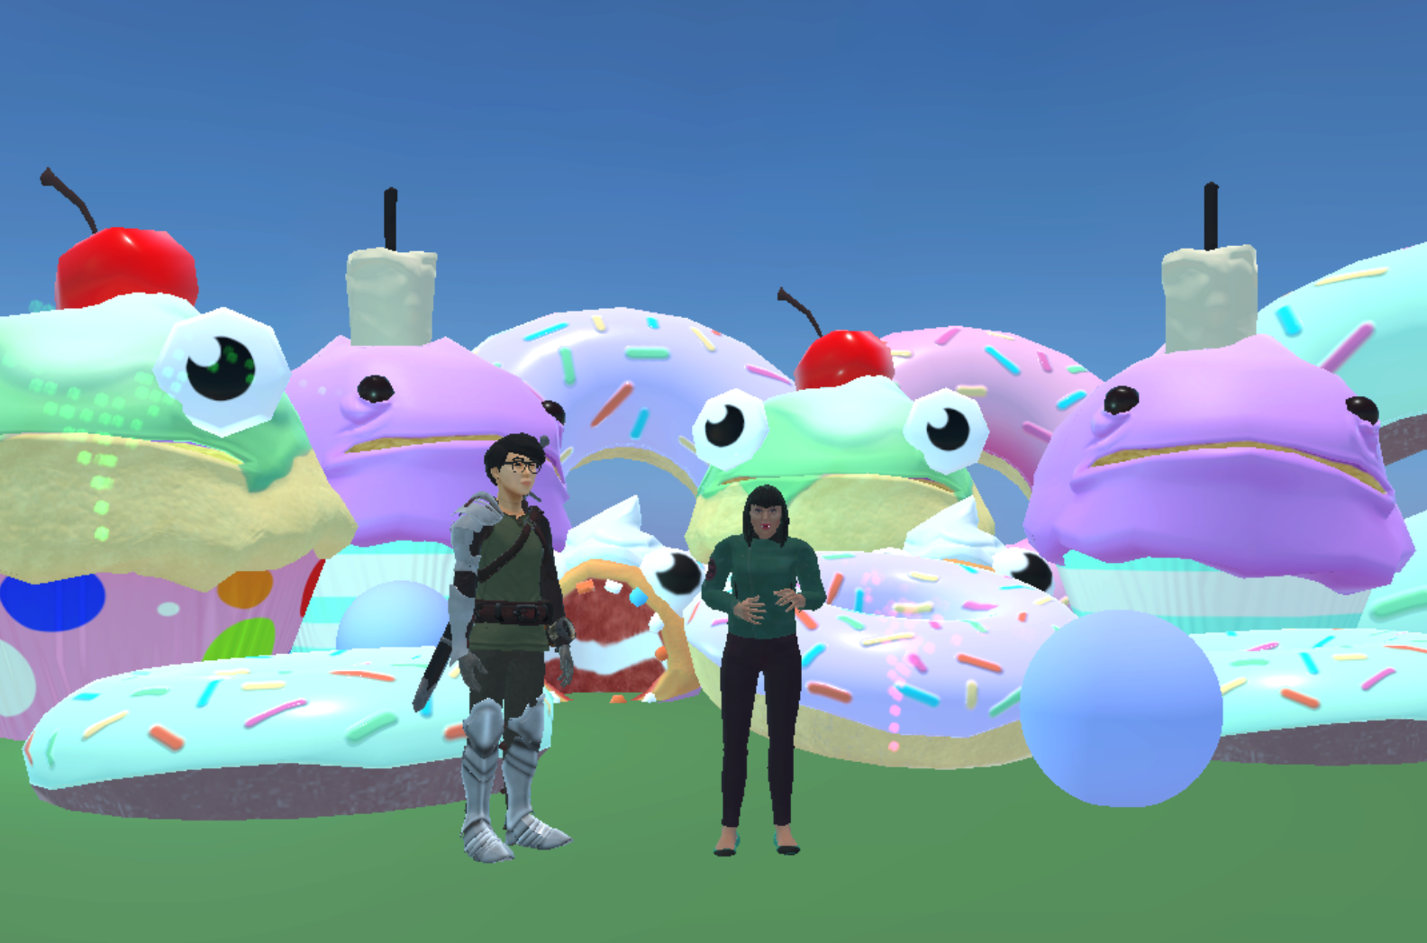
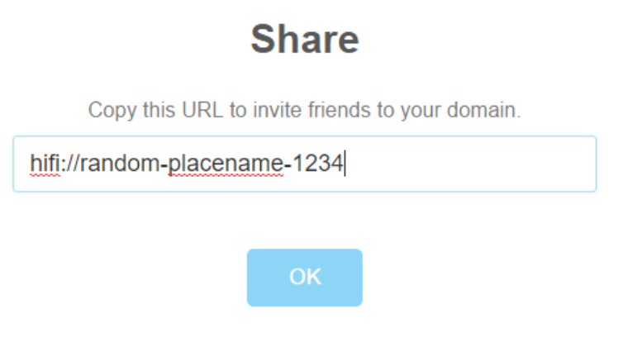
Instantly shareable

Slide 17
PIPELINE
Getting Started in High Fidelity
START
Your Home
START BUILDING
Share your home
Explore
Start sandbox
& open interface
Set your settings to your liking
Furnish your place with cool stuff
right click tray to invite friends
Click ‘GO TO’ TO EXPLORE NEW WORLDS

Slide 18
Thank You!
Jazmin Cano
Marketing & Event Coordinator
HIGH FIDELITY

Slide 19
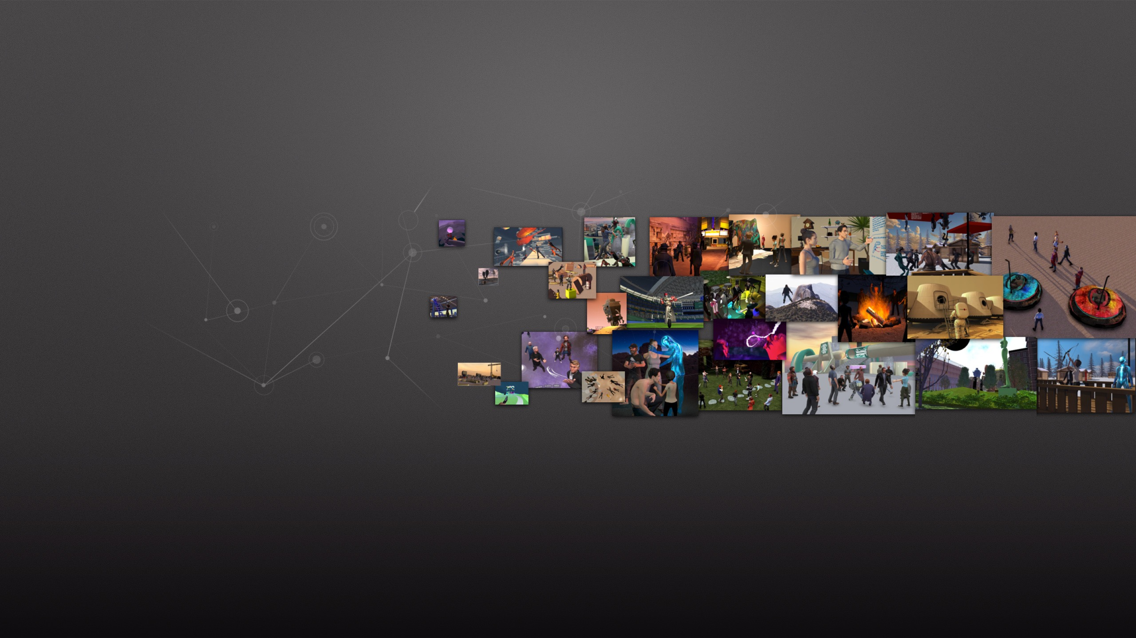
Links and Resources
              highfidelity.com/download
              highfidelity.com/docs
              Jazmin@highfidelity.io
              twitter.com/highfidelityinc
              facebook.com/highfidelityinc

