Slide 1

The Next Disruptor

Slide 2
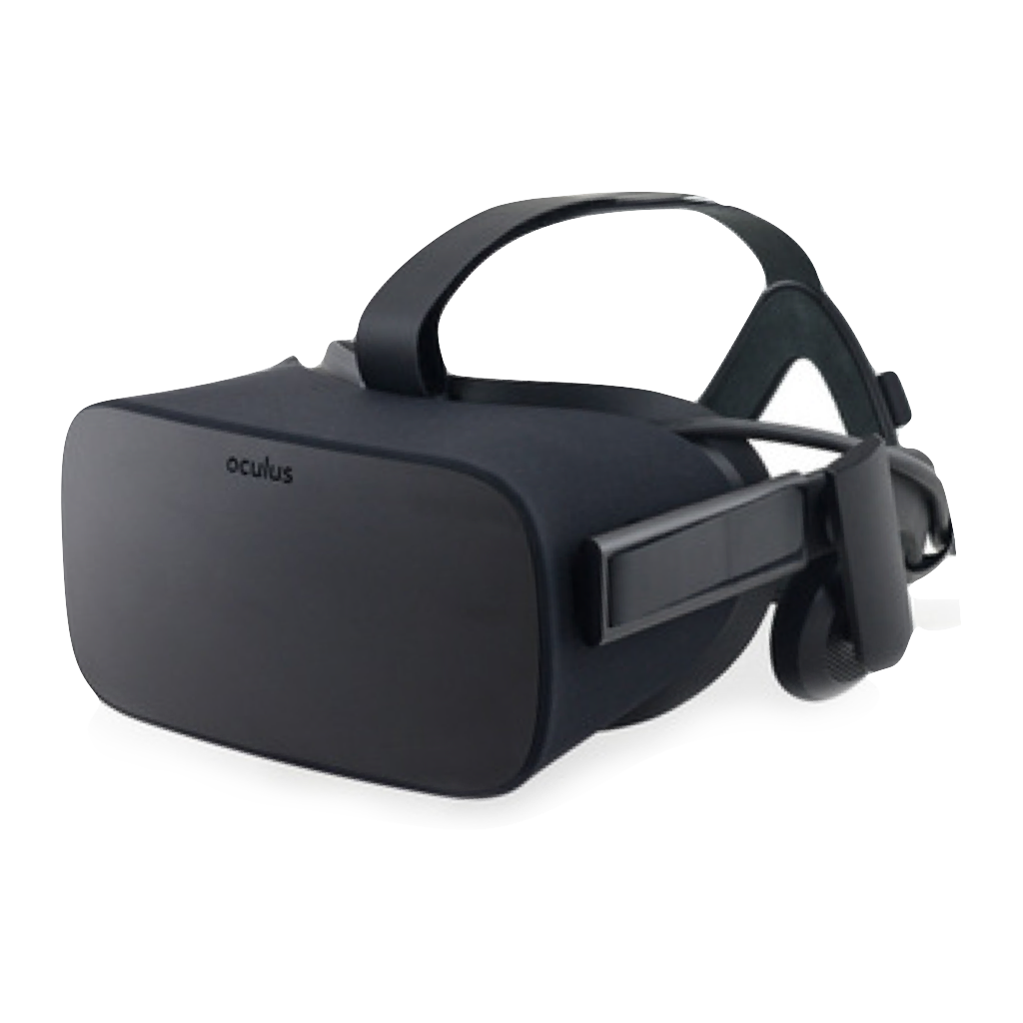
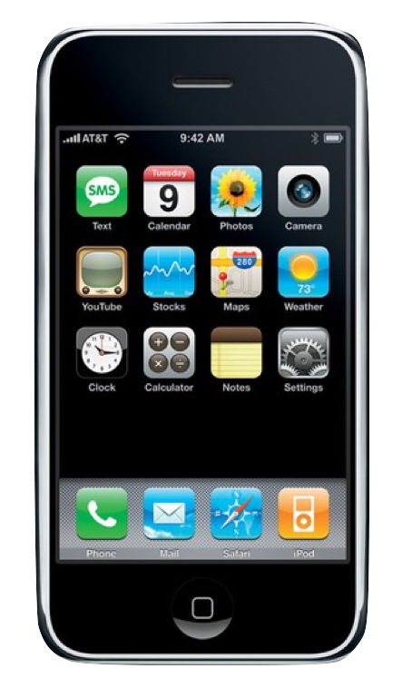
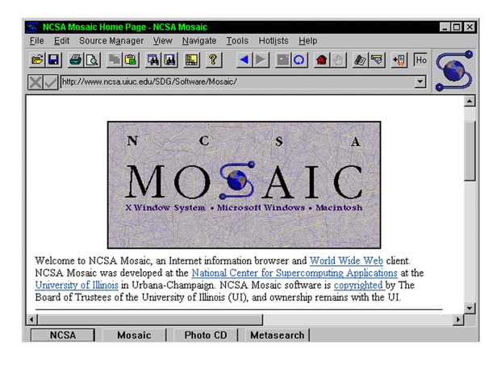

Disruptors are some kind of
Communication Technology
The
Internet
Smart
Phone
Virtual
Reality

Slide 3
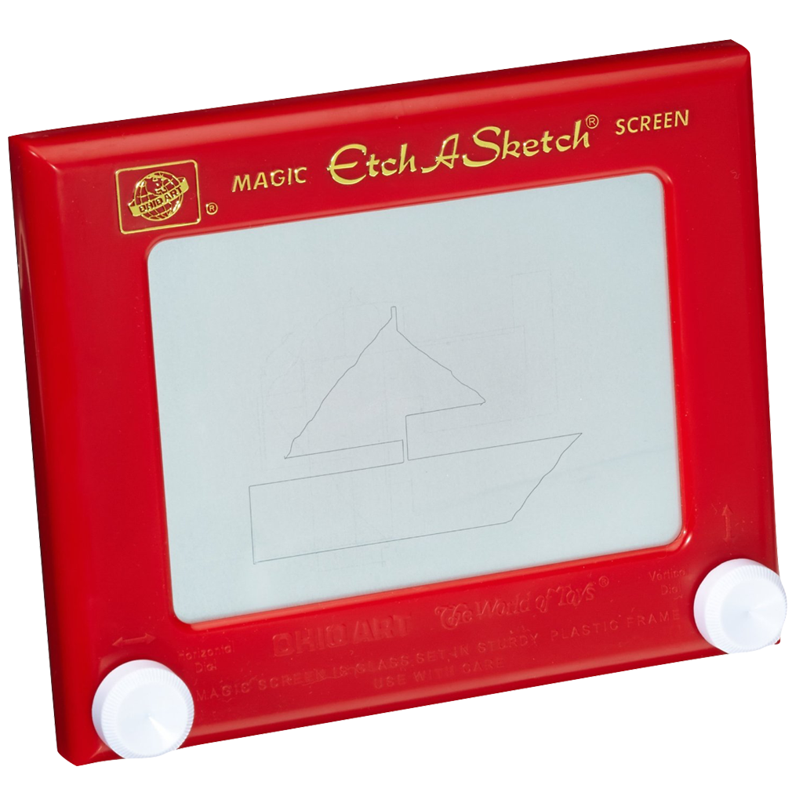
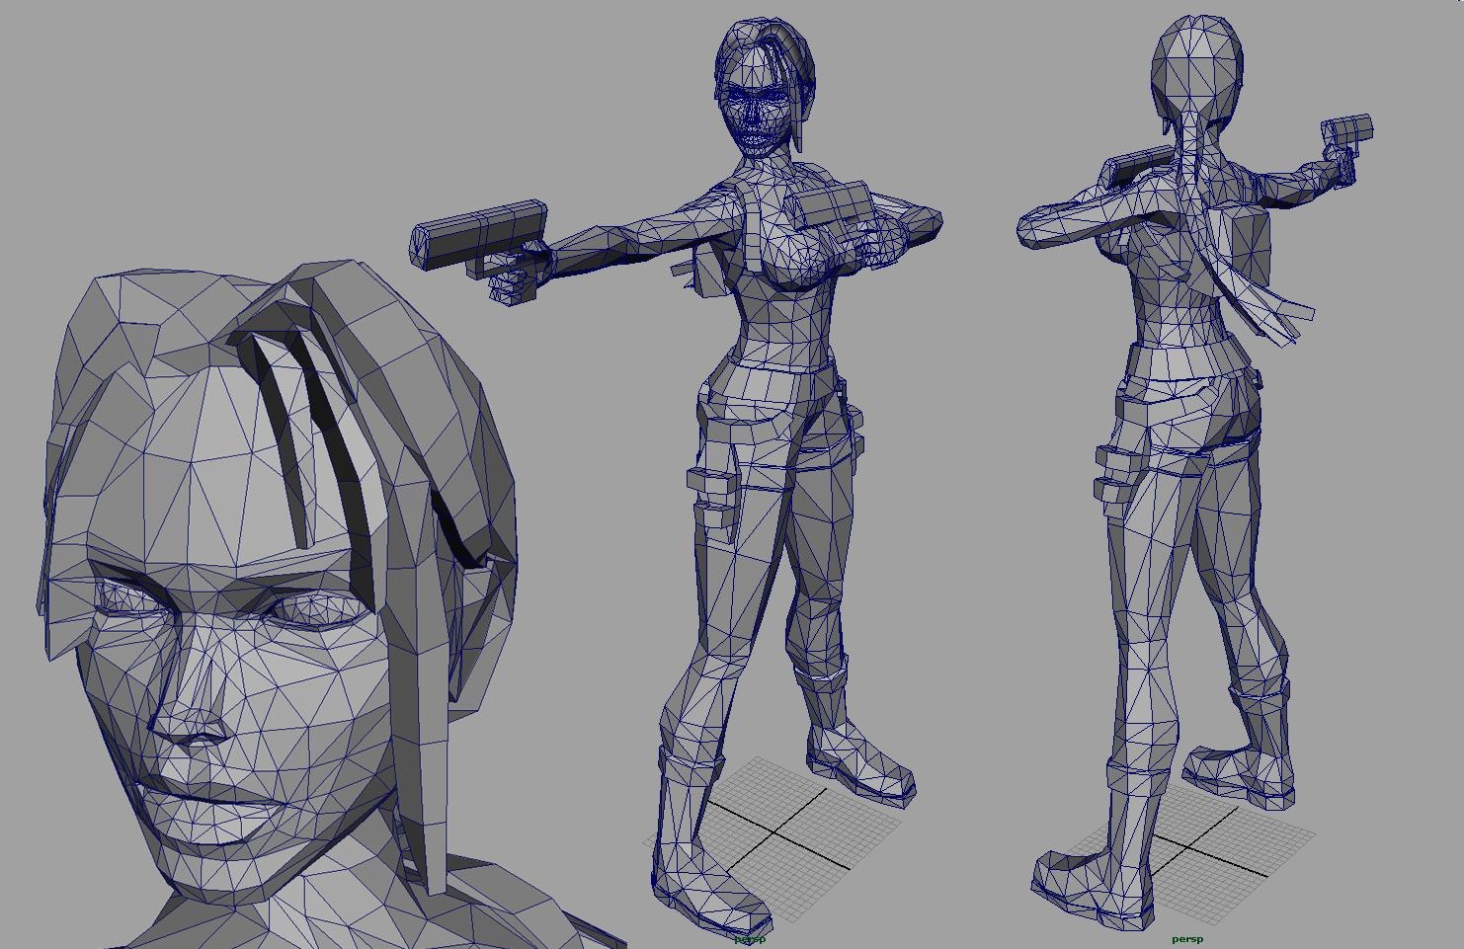
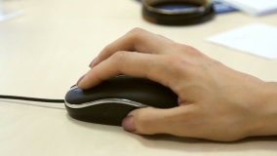

Through the Looking Glass
It’s all about degrees of freedom (DOF)...
1 DOF = Bad way to draw in 2D
2 DOF = Bad way to draw in 3D

Slide 4
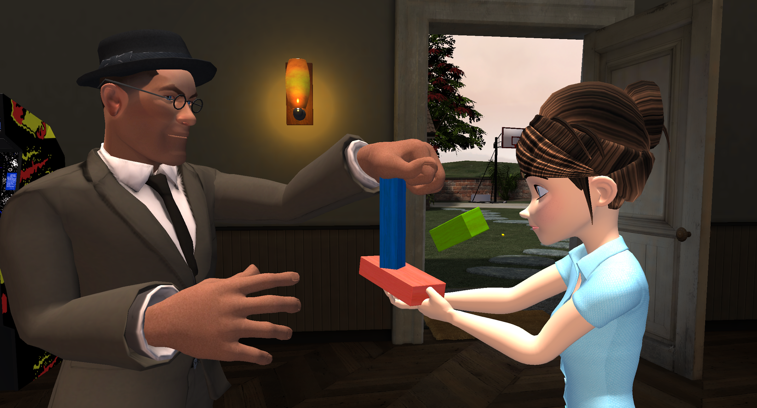
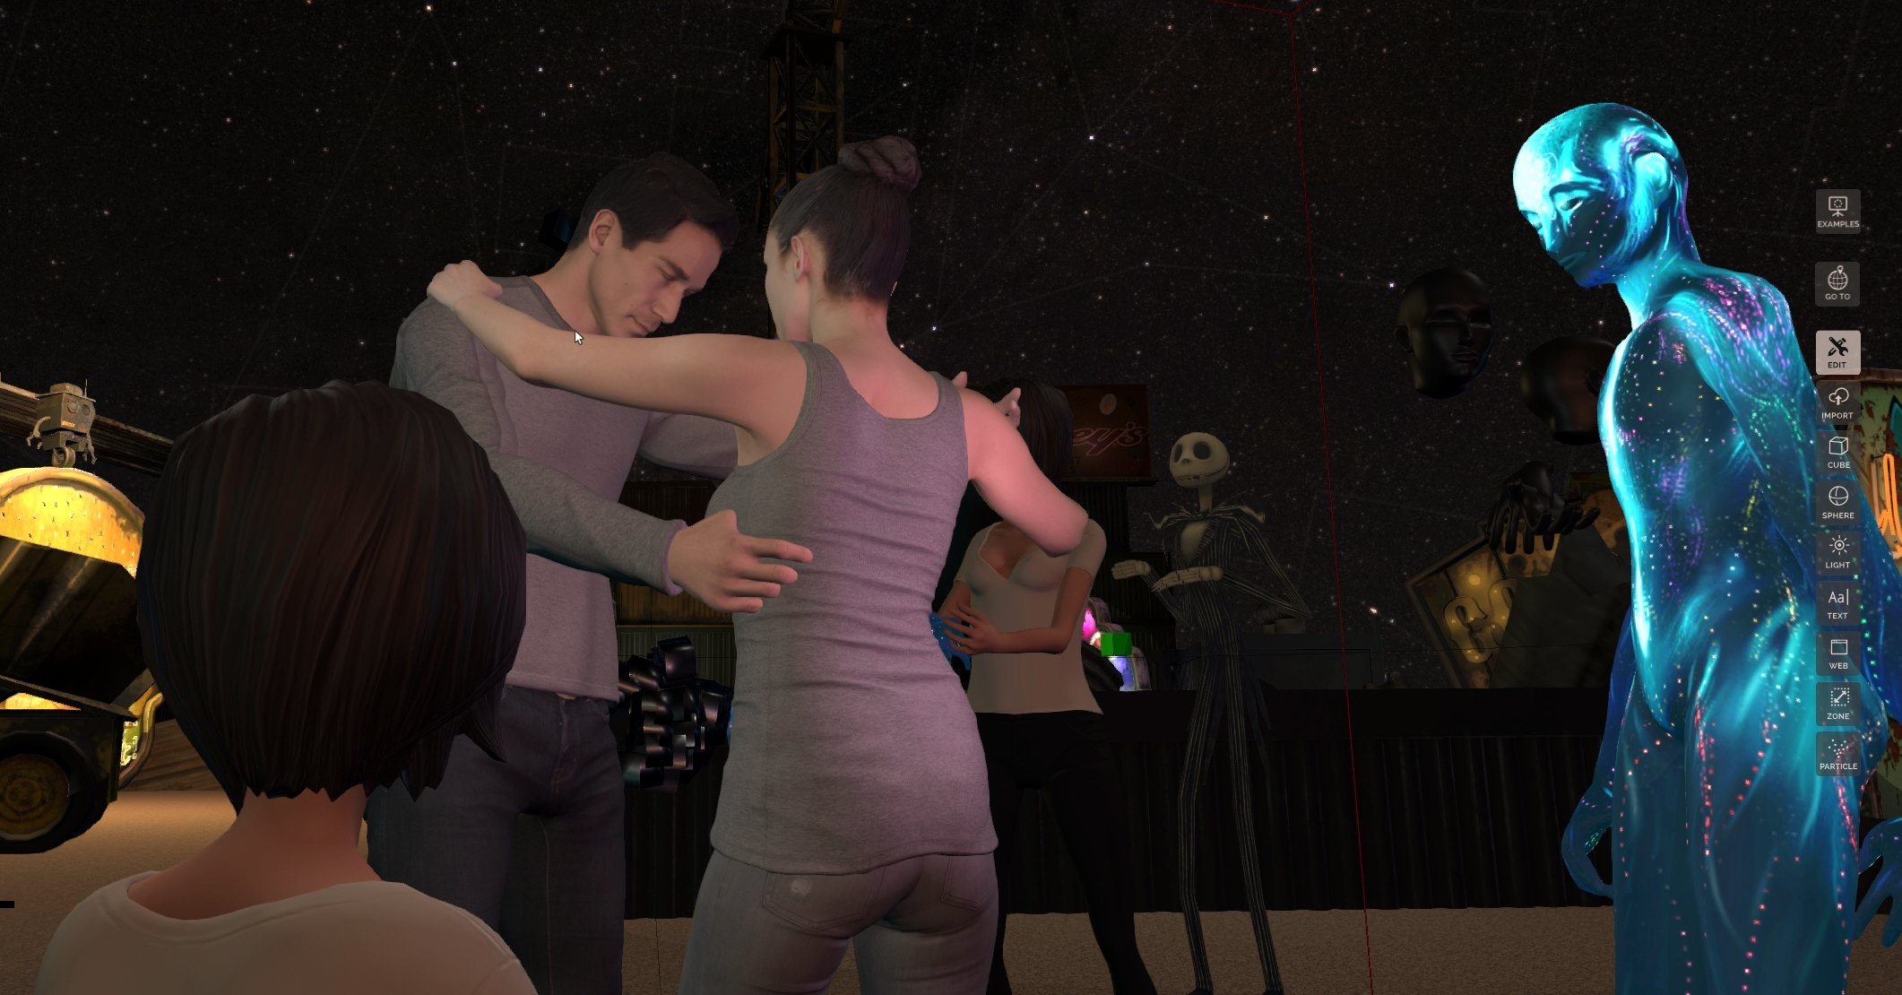
What if VR Replaces the Internet?
+
Natural Interaction in 3D
True Face-to-Face Communication
* Sources: TechCrunch, KZERO Worldwide

Slide 5
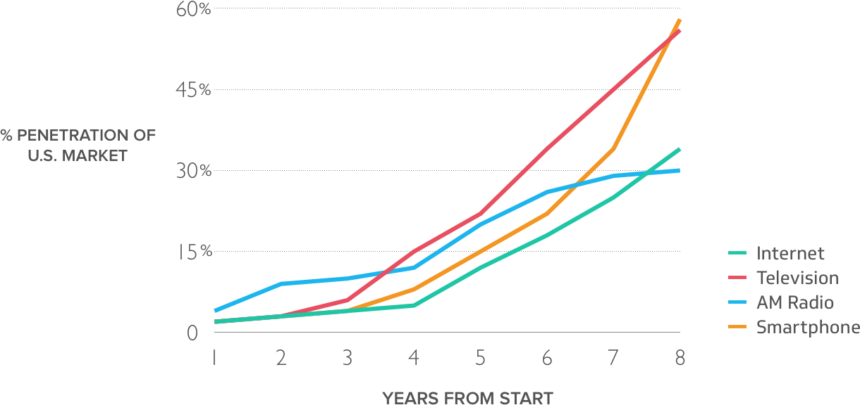
Worldwide daily use within 10 years

Slide 6
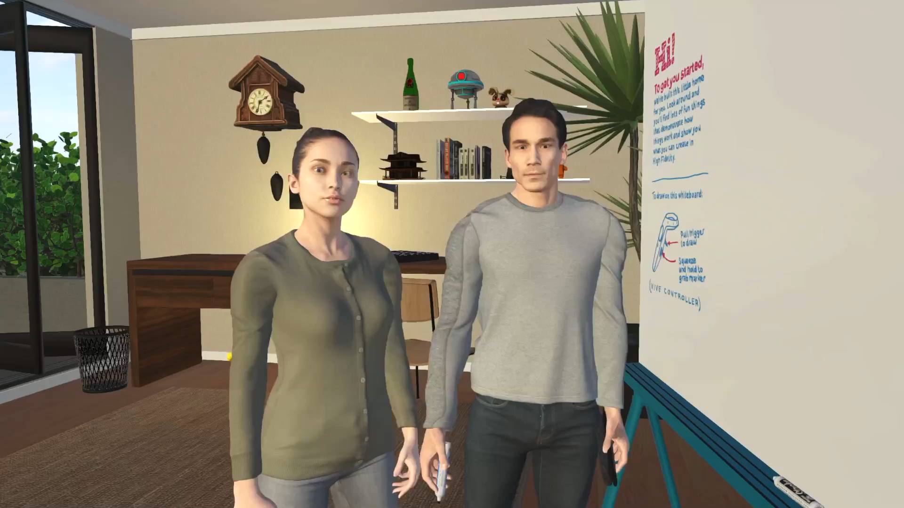

Slide 7

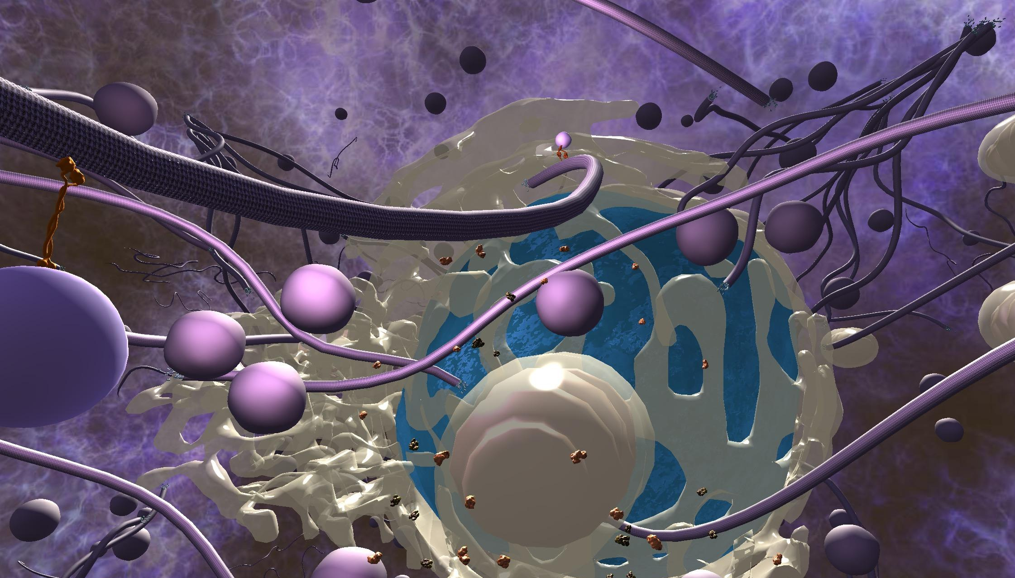
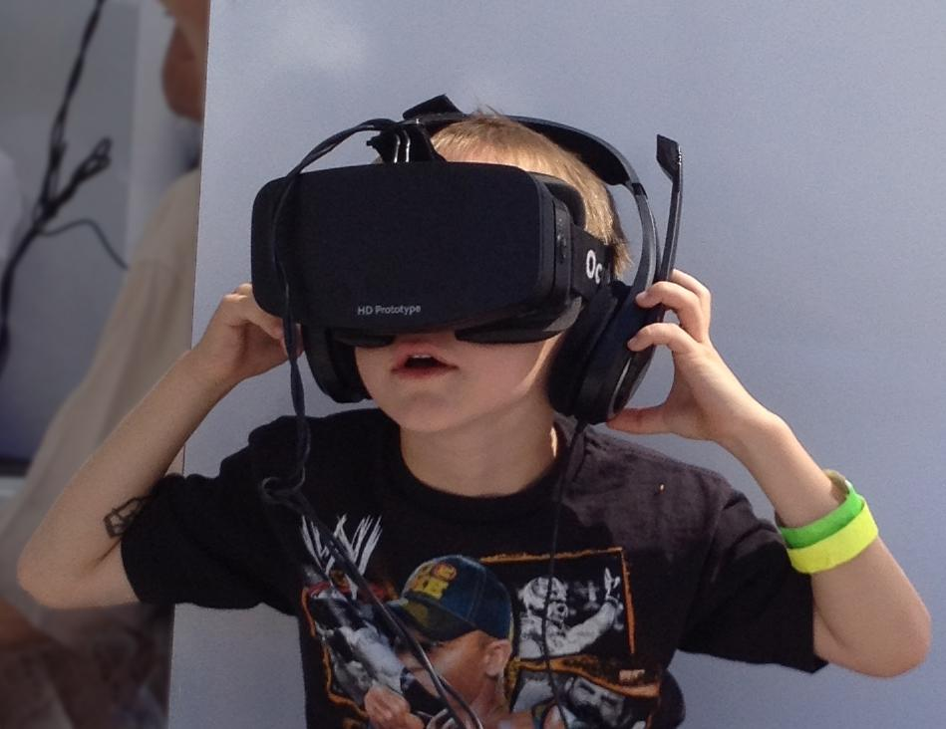
Education

Slide 8
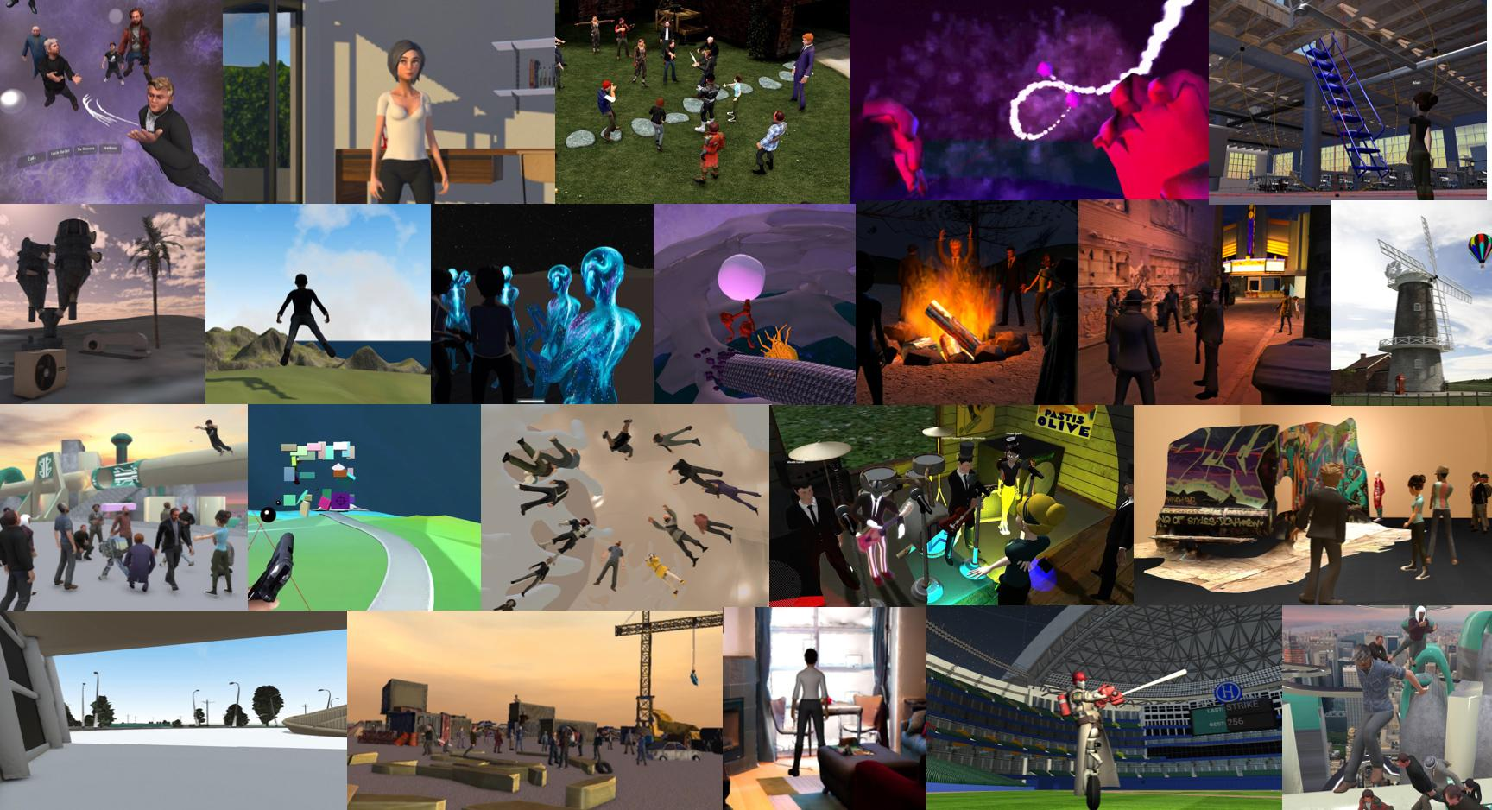
Events, meetings, shopping, exploration.

Slide 9
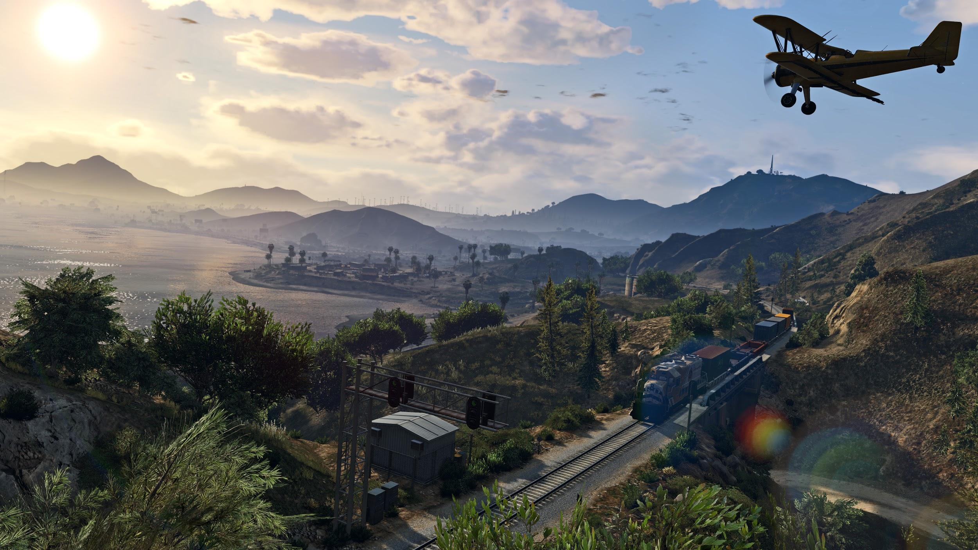
Bigger than Earth

Slide 10
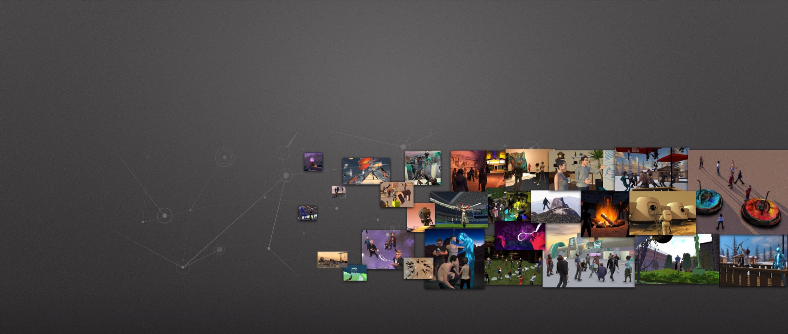


Links and Resources
              highfidelity.com/download
              twitter.com/highfidelityinc
              highfidelity.com/docs
              facebook.com/highfidelityinc

