Slide 1


Investor Presentation
Q1, 2018
Confidential

Slide 2

An open source, blockchain-based VR platform

Slide 3

Our Mission:
Get one Billion people daily using Virtual Worlds
MARKET OPPORTUNITY
$1T economy
50M servers
20K transactions per second virtual goods

Slide 4
Leading Use Cases:
Education Entertainment Events vCommerce

Slide 5

Business Model:
Marketplace Transactions
Advertising
Crypto-currency inflation

Slide 6
Team
Dream team with extensive experience building Virtual Worlds, Streaming Media, Virtual economies, social games. Leading an amazing team of 50 from diverse skillsets, incl Unity, Audio codecs, Game Designers, …
CEO CTO COO CPO / Co-founder

Slide 7


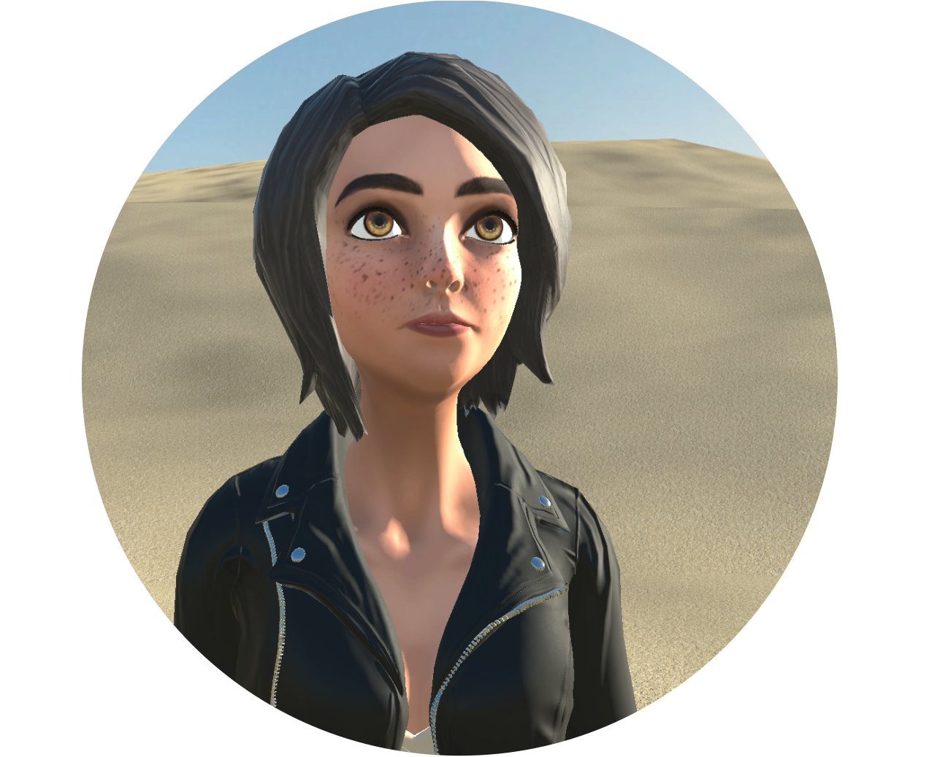

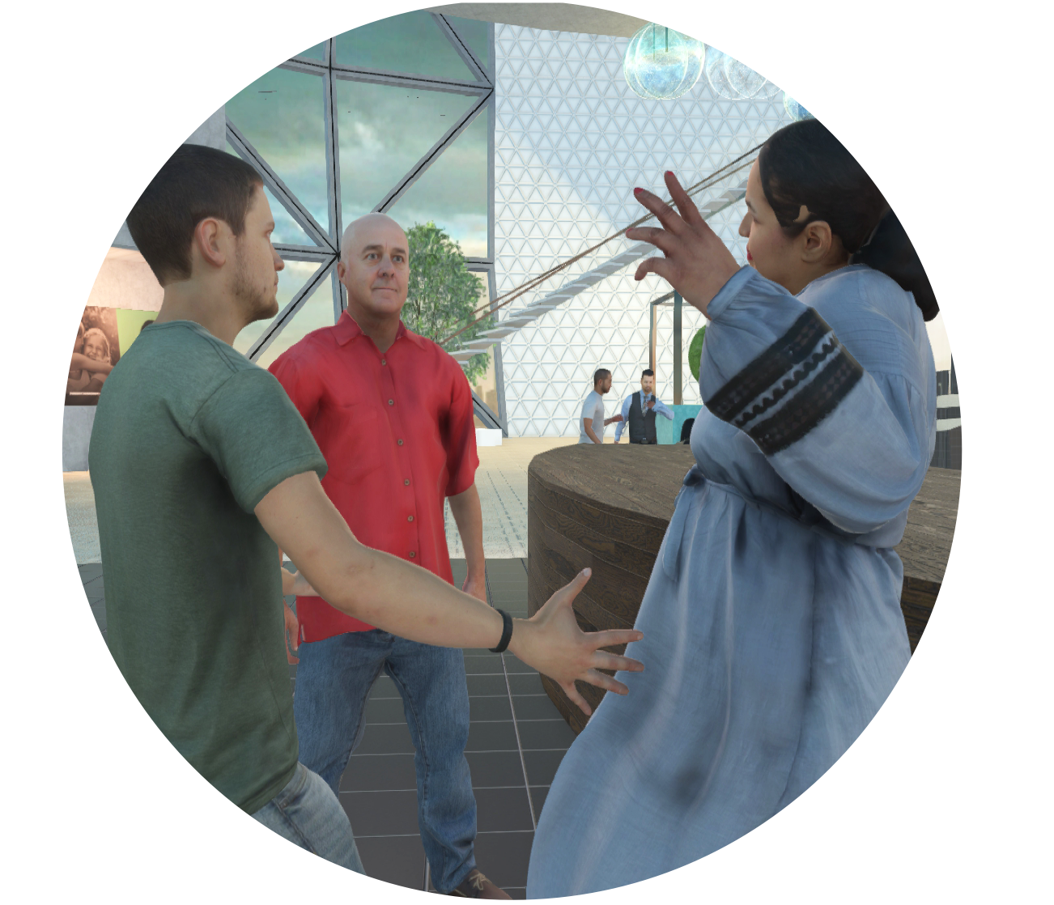
The Platform
Blockchain for durable public asset storage
Scale to largest audience and environments
Low-latency for lifelike face-to-face experience
Open-Source client and server software
Most detailed and expressive avatars
Cryptocurrency for easy global monetization

Slide 8

CONCURRENCY | 100 | 50 | 30 | 30
LIVE EDITING? | YES | NO | NO | NO
PROGRESSIVE DOWNLOAD | YES | NO | NO | NO
BROADCAST OPTION? | YES | NO | NO | YES
LIVE-STREAMING? | YES | NO | NO | NO
FULL-BODY TRACKING | YES | NO | YES | YES
FACIAL EXPRESSION TRACKING | YES, WITH PLUGIN | NO | NO | NO
EYE TRACKING | YES, WITH PLUGIN | NO | NO | YES, OBSOLETE
CURRENCY / PAYMENT SYSTEM | YES | YES | NO | NO
MARKETPLACE | YES | YES | UNITY MARKETPLACE | NO
PHOTOREALISTIC AVATARS | YES | YES | NO (10K TRIANGLES) | NO
SELF-HOSTED SERVERS | YES | NO | NO | NO
OPEN SOURCE | YES | NO | NO | NO
PRICING | FREE | PAID HOSTING | FREE | N/A

Slide 9
Beta Progress
Press clippings, quotes, logos
Quotes from beta users / steam reviews
Number of signups, servers deployed

Slide 10
Q2 2018
Q2 2018
SUMMER 2018
Q3 2018
Q4 2018
Mobile client
Blockchain Identity and Reputation
Full Product Launch
Advertising network
Large audience support
Roadmap

Slide 11
Basic marketplace commerce
Connect to Ethereum
Currency Exchanges
Token to enable stable exchange rate
Identity
Reputation
Derivative Rights
Use with real-world goods
Blockchain Roadmap

Slide 12

Q2 2018
Q2 2018
SUMMER 2018
Q3 2018
Q4 2018
Roadmap
Mobile client
Blockchain identity and reputation
Full product launch
Advertising network
Large audience support

Slide 13
Basic marketplace commerce
Connect to Ethereum
Currency Exchanges
Token to enable stable exchange rate
Identity
Reputation
Derivative Rights
Use with real-world goods
Blockchain Roadmap

Slide 14
Every time the measured exchange rate increases by some amount, print more currency and distribute it so that it gets to the people who want it.
To achieve that goal:
Create a fixed number of dividend tokens and give or sell them to a number of different holders.
Give the newly printed currency evenly out to the holder of each dividend token.
Dividend holders will sell the currency they received on the open market, reducing the exchange rate.
Goal:
Token to stabilize exchange rate during economy growth

Slide 15
Exchange rate triggers new Currency Dividend
Exchange Rate Dividend Threshold
Open Market Exchange Rate
Exchange Rate Target
Growth in economy increases exchange rate until threshold is reached.
Dividends gradually sold back into market, stabilizing rate.
Total Currency in Circulation
Dividend to shareholders

Slide 16

Investment Offering:
Dividend tokens receive % Of GDP growth
Investor pre-sale, Q1 2018
Continuous token sales of 1% weekly for period of one year

Slide 17
Links and Resources
              highfidelity.com/download
              twitter.com/highfidelityinc
              highfidelity.com/docs
              facebook.com/highfidelityinc
Q1, 2018
Confidential

